Slide 1
Module: Social entrepreneurship and social enterprises
(including green entrepreneurship)

Slide 2
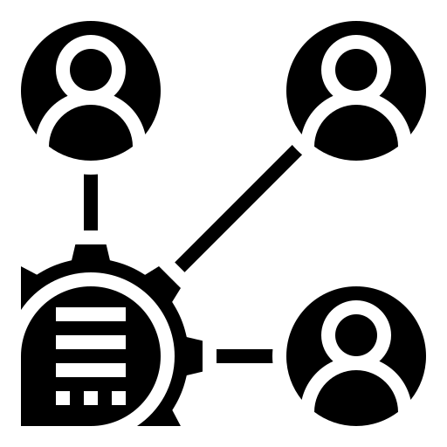
Stakeholders Analysis and Relationships

Slide 3
What it means stakeholders mapping?
Stakeholder mapping is the visual process of laying out all the stakeholders of a product, project, or idea on one map. The main benefit of a stakeholder map is to get a visual representation of all the people who can influence your project and how they are connected.
Sometimes, people confuse stakeholders with shareholders. While shareholders own a part of a public company (through shares of stock) and are interested in the company’s performance, it doesn’t mean they should be stakeholders of each project or product launched by the company. Stakeholders can work on a more granular level and they are also often interested in the project’s or product’s performance, not just because it affects the company’s stock performance.

Slide 4
When a stakeholder map is critical?
Building a product
Penetrating a market
Starting a new project

Slide 5
What should a stakeholder management plan include?
Prioritization of stakeholders
Stakeholder expectations
Communication rules
Action plans

Slide 6
Benefits of Stakeholder Engagement:
Education
Effective Decision Making
Trust
Cost Savings
Risk Management
Accountability

Slide 7
Stakeholder mapping in 4 steps:
1. Define your stakeholders
2. Analyze stakeholders by impact and influence
3. Plan stakeholder communications and reporting
4. Engage with your stakeholders

Slide 8
Stakeholders Analysis:
Operational partners: | Community partners : | Institutional partners: | Financial partners | Other partners
Corporates, Clients, Others | Incubators, other CSOs, community initiatives, entrepreneurship networks, etc. | Ministries, local authorities, international institutions, schools, etc. | Donors, others | Media, others

