Slide 1
Module: Social entrepreneurship and social enterprises (including green entrepreneurship)

Slide 2

Steps for creating a social enterprise

Slide 3
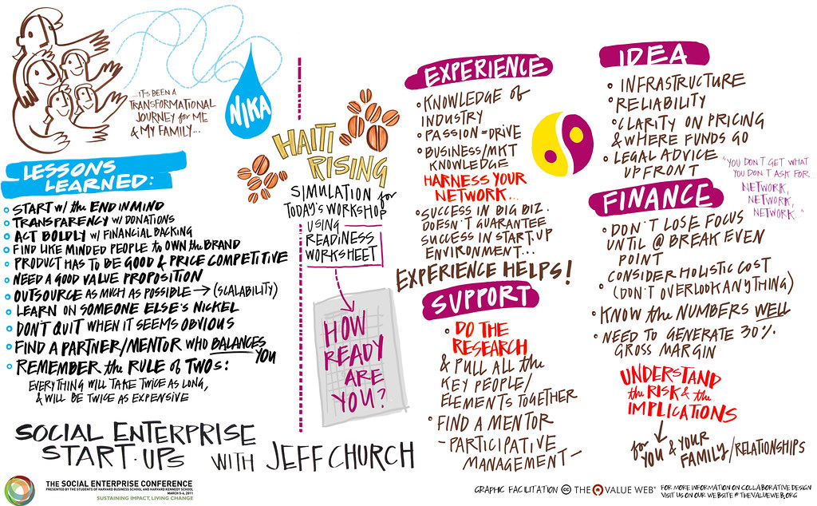
Questions to take into consideration:
9/25/2021
3
Notes:
Line spacing + Page numbers
3

Slide 4
1. Identify a problem-offer a solution
Who and why will I help?
What is my motivation?
What are my beliefs?
How can I help? What specific actions am I going to take to realize my intention?
What results do I expect?
What is my understanding of the problem?
What kind of experience do I have with the problem I am aiming to solve?
How can my experience help me to create specific results?
What/Who can help me to achieve better understanding and to have better insight into the problem?
9/25/2021
4

Slide 5
2. Conceptualize your product
Where does my idea fit in?
Within which framework does my idea work?
Competitive advantage – What unique quality will my product bring compared to competition?
Business alignment – How is my product related to my business social mission?
Customers – What are the wishes and needs of my target customers?
Execution – What resources, processes, risks, partners and suppliers in the market do I need?
Business value – What are the benefits of the realization of the idea?
9/25/2021
5

Slide 6
3. Gather a team
3. Cather a team
What should guide you when you choose your co-workers?
How does the teamwork?
How to communicate within the team?
9/25/2021
6

Slide 7
4. Initial financing
What is your financial framework?
Local with small number of customers or do you want to achieve a greater impact?
How much money do you need?
What specific type of business model will you choose?
How will you get the initial funding?
Will you be looking for a business loan or can you afford self-financing?
Have you provided a legal background and measurable indicators before starting?
What is your financial framework?
Local with small number of customers or do you want to achieve a greater impact?
How much money do you need?
What specific type of business model will you choose?
How will you get the initial funding?
Will you be looking for a business loan or can you afford self-financing?
Have you provided a legal background and measurable indicators before starting?
9/25/2021

Slide 8
5. Legal framework
Is there a unique law for starting up and further organization of a social enterprise?
Will I be able to realize my idea in the legal framework of my country?
Taxes?
Sources of financing? Private donations, public grants, shares or loans.

Slide 9
5. Be visible - promotion
How to get people to support my enterprise?
Is there a target market?
How should my advertisements work?
Do I know my customers?
Do I target the market via social media or prefer live contacts on seminars or meetings?
9/25/2021
9

Slide 10

Business plan:
Who will be my business partners?
How is my enterprise different?
Who is the desired customer for my product?
How are the costs structured?
How to minimize risk factors?
9/25/2021
10

Slide 11
Summary:
Our business is making impact | Our target groups keep coming back
We’re getting our work done | We’re leaders
We’re delivering | Our team is growing
9/25/2021
11

