Slide 1
Module: Social entrepreneurship and social enterprises
(including green entrepreneurship)

Slide 2
Introduction to Social Entrepreneurship, Business Models and Local Examples

Slide 3
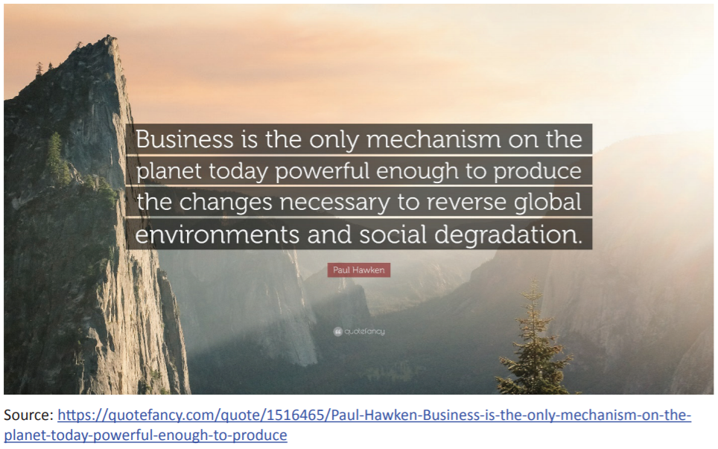
Notes:
https://quotefancy.com/quote/1516465/Paul-Hawken-Business-is-the-only-mechanism-on-the-planet-today-powerful-enough-to-produce

Slide 4
Green entrepreneurship
Entrepreneurship: The capacity and willingness to develop, organize and manage a business venture along with any of its risks in order to make a profit. The most obvious example of entrepreneurship is the starting of new businesses. [Source: Business Dictionary]
Green entrepreneurship is the activity of consciously addressing an environmental and/or social problem/need through the realization of entrepreneurial ideas with a high level of risk, which has a net positive effect on the natural environment and at the same time is financially sustainable.
Green entrepreneur is someone who starts and runs an entrepreneurial venture that is designed to be green in its products and processes from the very moment it is set up.

Slide 5
How is green entrepreneurship different form common business entrepreneurship?
Differences:
The green entrepreneurs have environmental and social goals into their core business, these goals are the reason their business exists, not just a side effect
Education of the consumer towards the specifics of the green products/services
Environmental values are part of the company values
Green entrepreneurship can be (sometimes) associated with higher costs
Financial profit is a goal insofar as it helps sustain the business so that it can go on fulfilling its environmental goals and bringing benefits to the environment
Resemblances:
Both have business goals, business plans, etc.
Both are looking for profit

Slide 6
Social entrepreneurship
Social entrepreneurship is the use of the techniques by start-up companies and other entrepreneurs to develop, fund and implement solutions to social, cultural, or environmental issues.
It is the process of starting and growing a for-profit business to impact social issues positively.
If you compare this definition to the definition of green entrepreneurship, what do you notice?
both are talking about solving environmental AND social problems
both are very new domains and definitions are still being debated.
Notes:
Tell the students that there are companies that are interested not only in climate change or environmental issues, but also in social change. Introduce the term social entrepreneurship.
If you compare this definition to the definition of green entrepreneurship, what do you notice?
Students will probably notice that in both cases we are talking about solving environmental AND social problems, so they might get confused what the difference between green and social entrepreneurship is. It is important that you emphasize the point that these are very new domains and definitions are still being debated.

Slide 7
Social entrepreneurship is all about recognizing the social problems and achieving a social change by employing entrepreneurial principles, processes and operations.
It is all about making a research to completely define a particular social problem and then organizing, creating and managing a social venture to attain the desired change. The change may or may not include a thorough elimination of a social problem. It may be a lifetime process focusing on the improvement of the existing circumstances.

Slide 8
The difference between social and common business entrepreneurship
While a general and common business entrepreneurship means taking a lead to open up a new business or diversifying the existing business, social entrepreneurship mainly focuses on creating social capital without measuring the performance in profit or return in monetary terms. The entrepreneurs in this field are associated with non-profit
sectors and organizations. But this does not eliminate the need of making profit. After all entrepreneurs need capital to carry on with the process and bring a positive change in the society.

Slide 9
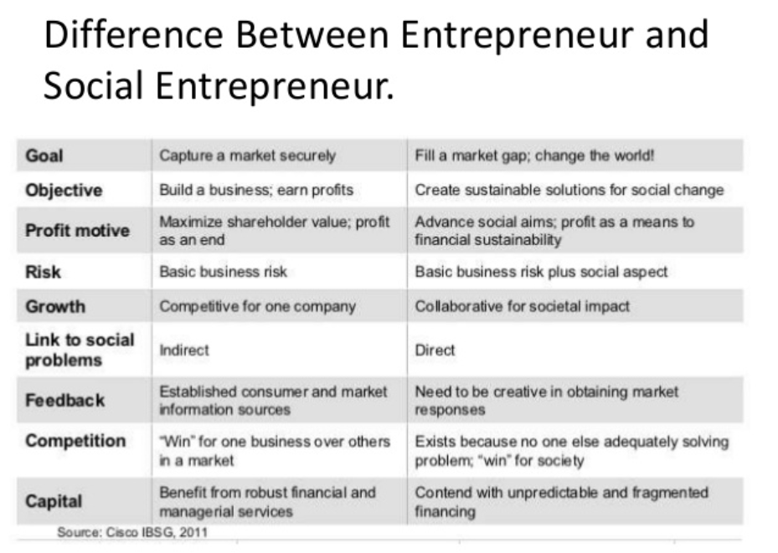
Difference between entrepreneur and social entrepreneur
Notes:
https://www.slideshare.net/tribhuvansaini3/social-entrepreneurship-68254189

Slide 10
What Is a Social Entrepreneur?
A social entrepreneur is someone who starts a business as a way to create a positive impact on a social issue.
The person who coined the term “social entrepreneur,” Bill Drayton, said, “The life purpose of the true social entrepreneur is to change the world.” However, social entrepreneurs often measure their success based on a triple-bottom-line: social, environmental, and economical.
Social: The business’s ability to create positive change, and its impact on social issues.
Environmental: The business’s environmental impact and carbon footprint.
Economic: Social enterprises need to turn a profit to continue to operate and grow.

Slide 11
Characteristics of a Social Entrepreneur
Social entrepreneurs are individuals who start businesses to help a particular social cause.
According to the Schwab Foundation for Social Entrepreneurship, social entrepreneurs share several characteristics. They:
Achieve large scale social change.
Focus on the social or ecological change they want to make while earning money to support the change.
Innovate when looking for a solution to a social problem.
Use feedback to adapt and refine.

Slide 12
The Process of Social Entrepreneurship
1. Find an opportunity
2. Develop a business concept
3. Figure out what success means and how to measure it
4. Acquire the right resources
5. Launch and grow
6. Attain goals

Slide 13
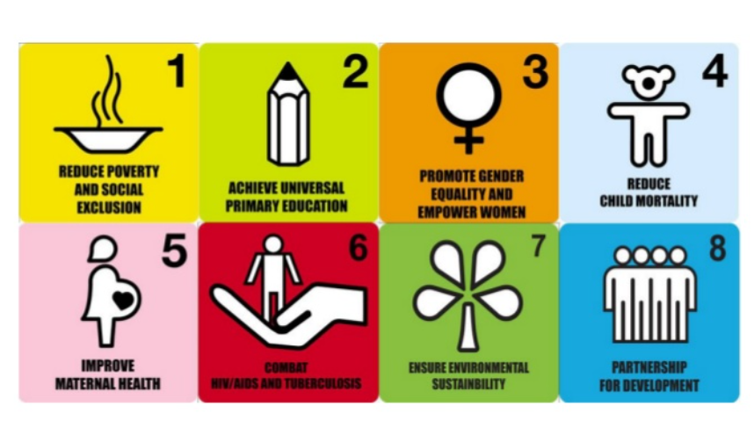
What challenge do you badly want to solve?
Notes:
https://www.slideshare.net/KevinCruz1/introduction-to-social-entrepreneurship-14679171

Slide 14
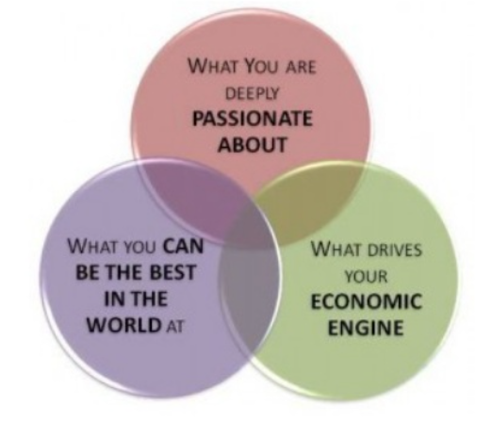
Notes:
https://www.slideshare.net/KevinCruz1/introduction-to-social-entrepreneurship-14679171

Slide 15
Business concept (business model)
A business model is an outline of how a company plans to make money with its product and customer base in a specific market. At its core, a business model explains four things:
What product or service a company will sell
How it intends to market that product or service
What kind of expenses it will face
How it expects to turn a profit

Slide 16
Types of business models
Most common types of business models
1. Subscription model
2. Bundling model
3. Freemium model
4. Product to service model
5. Leasing model
6. Crowdsourcing model
7. Retailer model
8. One-for-one model
9. Franchise model
10. Distribution model
Notes:
https://www.nerdwallet.com/article/small-business/what-is-a-business-model

Slide 17
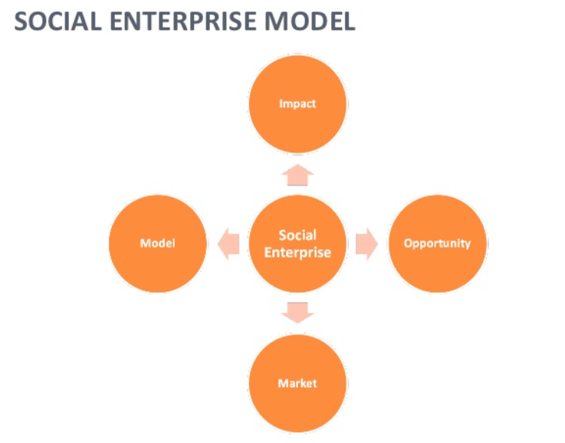
Social enterprise model
Notes:
https://www.slideshare.net/KevinCruz1/introduction-to-social-entrepreneurship-14679171

Slide 18
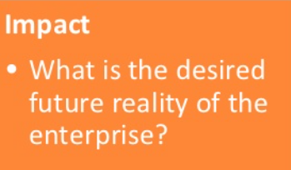
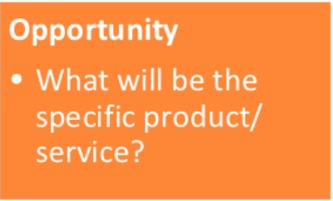
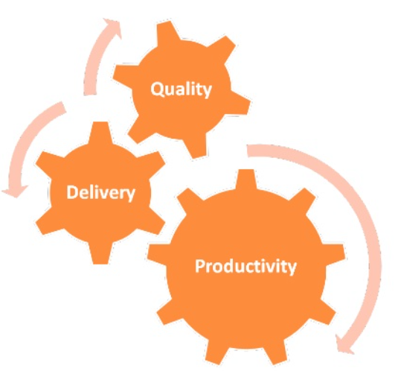
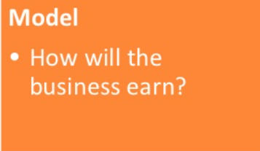
POINTS TO PONDER
The profit of social enterprises is its level of social impact.
Good business now is all about being in the business of doing good.
What do you see happening in your community in the future?
What is your big idea? What do you specifically offer?
How will your business earn?
What makes you unique?
What is your target market?
Notes:
https://www.slideshare.net/KevinCruz1/introduction-to-social-entrepreneurship-14679171

Slide 19
Why does social entrepreneurship matter?
Employment development: The first major economic value that social entrepreneurship creates is the job and employment. Estimates ranges from one to seven percent of people employed in the social entrepreneurship sector.
Innovation/New Goods and Services: Social entrepreneurs develop and apply innovation important to social and economic development and develop new goods and services. Issues addressed include some of the biggest societal problems such as HIV, mental ill-health, illiteracy, crime and drug abuse which, importantly are confronted in innovative ways.
Equity Promotion: Social entrepreneurship fosters a more equitable society by addressing social issues and trying to achieve ongoing sustainable impact through their social mission rather than purely profit-maximization.

Slide 20
How to measure the success?
For-profit entrepreneurs typically measure performance using business metrics like profit, revenues and increases in stock prices. Social entrepreneurs, however, are either non-profits, or they blend for-profit goals with generating a positive "return to society". Therefore, they use different metrics. Social entrepreneurship typically attempts to further broad social, cultural, and environmental goals often associated with the voluntary sector in areas such as poverty alleviation, health care and community development.
What is profit?
How do we count it?
What is “social return on investment” for venture philanthropists?
Can we compare investments?

Slide 21
Challenges, opportunities, trends and risks of social entrepreneurship
Main Challenges at Present:
Money
Competition
Demonstrating effectiveness
Technology
Trust
Human resources
Public-sector relations
Main Opportunities at Present:
Demographic shifts
New philanthropy
Heightened awareness of sector
Increased social welfare spending through sector (entitlement expansion, welfare reform)
Main Trends at Present:
Explosive growth
Attention to marketing and management movements
Commercial ventures
Development of umbrella organizations and formal education
Effectiveness in competing economically and politically
Main Risks at Present:
Identity loss, “mission creep”
Industry concentration
Pressure on managers for results
Loss of public trust

Slide 22
Three main challenges of social entrepreneurs
Because the world of social entrepreneurship is relatively new, there are many challenges facing those who delve into the field.
First, social entrepreneurs are trying to predict, address, and creatively respond to future problems. Unlike most business entrepreneurs, who address current market deficiencies, social entrepreneurs tackle hypothetical, unseen or often less-researched issues, such as overpopulation, unsustainable energy sources, food shortages. Founding successful social businesses on merely potential solutions can be nearly impossible as investors are much less willing to support risky ventures.
The lack of eager investors leads to the second problem in social entrepreneurship: the pay gap. Elkington and Hartigan note that "the salary gap between commercial and social enterprises… remains the elephant in the room, curtailing the capacity of [social enterprises] to achieve long-term success and viability." Social entrepreneurs and their employees are often given diminutive or non-existent salaries, especially at the onset of their ventures. Thus, their enterprises struggle to maintain qualified, committed employees. Though social entrepreneurs are tackling the world's most pressing issues, they must also confront skepticism and stinginess from the very society they seek to serve.
Another reason social entrepreneurs are often unsuccessful is because they typically offer help to those least able to pay for it. Capitalism is founded upon the exchange of capital (most obviously, money) for goods and services. However, social entrepreneurs must find new business models that do not rely on standard exchange of capital in order to make their organizations sustainable. This self-sustainability is what distinguishes social businesses from charities, who rely almost entirely on donations and outside funding.

Slide 23
Discussion point:
What are the main differences between social entrepreneurship and corporate social responsibility.

Slide 24
Social Entrepreneurship Examples
Some contemporary well-known and lesser-known social entrepreneurs include:
TOMS: When the company was founded, it applied its “one for one” concept to shoes. For every pair of TOMS shoes purchased, the company donated a pair to a needy child. The company has since expanded the one for one concept to eye wear, coffee, and tote bags.
Grameen Bank: Founder Muhammad Yunus provides micro-loans to those in need to help them develop financial self-sufficiency. Yunus received a Nobel Prize for his work in 2006.
Badala.org: Founded by Joelle McNamara while she was still in high school, Badala.org is an e-commerce site that creates jobs for African women by selling the products they make. Products range from jewelry to wooden kitchen utensils.

Slide 25
Discussion points:
Is there a local green entrepreneur that you know of and like? If yes, what do you like about him/her?
What about a national or international one?
How do you apply the “think green” principles in your daily life?

Slide 26
Conclusion
The field of social entrepreneurship is rapidly growing and attracting the attention of numerous volunteers. It has now become a common term in university campuses. The reason behind the increasing popularity of this product is that individuals get to do what they have been thinking for long. The extraordinary people put their brilliant ideas and bring a change in society against all odds.

Slide 27
Additional links
These are additional resources that you as a teacher can use in order to prepare for the lesson broadening your knowledge. You can also use these resources by assigning them to the students as out-of-class reading/viewing.
•22Awesome Socialhttps://jamboard.google.com/d/1cFfX76qKdCq3AFfyFO1RoS3gvHqMN7Blghh52sjPOE/edit?usp=sharing
Enterprise Business Ideas: https://www.thesedge.org/socent-spotlights/22-awesome-social-enterprise-business-ideas.
• 23 Green Business Ideas for Eco-Minded Entrepreneurs: https://www.businessnewsdaily.com/5102-green-business-ideas.html#sthash.B26NlEvr.dpufhttp://www.businessnewsdaily.com/5102-green-business-ideas.html
• RayAnderson:
The business logic of sustainability:
http://www.ted.com/talks/ray_anderson_on_the_business_logic_of_sustainability (15:44 min.). In one of the most powerful talks ever about the need for businesses to transform, Ray Anderson, CEO of Interface, gives a convincing account of the business case for sustainability. At his carpet company, Ray Anderson has increased sales and doubled profits while turning the traditional “take / make / waste” industrial system on its head. In a gentle, understated way, he shares a powerful vision for sustainable commerce. (Subtitles available in Romanian, Greek and Bulgarian)

