Slide 1
Module: Social entrepreneurship and social enterprises (including green entrepreneurship)

Slide 2
PROTOTYPE

Slide 3
What is a Prototype
Prototyping is a foundational process for developing a new product through the physical representation of an idea. Prototyping helps designers turn a concept into a functioning item. Using basic sketches and rough materials, the prototype may be a simple drawing or rough model that helps innovators determine what they need to improve and fix in their design.
A prototype is a rudimentary working sample, model, mock-up or just a simulation of the actual product based on which the other forms (Minimum Viable Product, final product, and variations) are developed.
This stage in the inventing process is possibly the period of greatest learning
Making a prototype by hand is a great way to start bringing your product to life. Remember, there are no rules! Give yourself permission to experiment.

Slide 4
Importance of Prototype
Prototype is the preliminary version of the actual product developed to:
Validate the design of the product,
Observe how prospecting customers are using the product,
Present to investors or licensees,
Protect the Intellectual property,
Remove kinks in manufacturing,
Test and refine the final product.

Slide 5
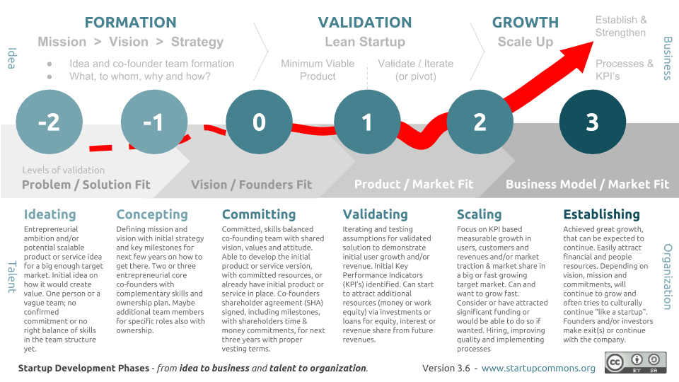
Startups stages
Notes:
https://www.startupcommons.org/startup-development-phases.html

Slide 6
Idea reality check
Before starting with building a prototype, you need to ask yourself these questions: 1. Does your customer have the problem that you are trying to solve? 2. Will they pay for it?
3. Will they pay YOU for it?
4. Can you build the solution for that problem?

Slide 7
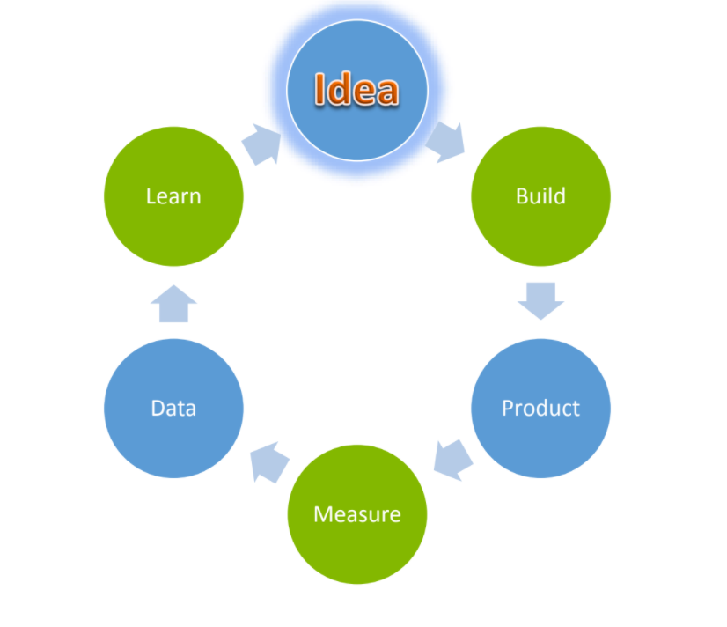
Build – measure – get feedback - improve

Slide 8
Prototype Methodology
1. Make a prototype - A good advice is to start “prototype early, prototype often.” Most literature on product prototyping advises to prototype your invention as early as possible.
2. Test your product and get reviews from users
3. Refine the design by applying feedback
4. Repeat!

Slide 9
What is a good prototype?
Representation: A prototype is a representation of the actual product. It represents how the product will look and/or work like.
Precision: More precise the prototype, better the response and feedback.
Functional: A good prototype performs the basic functions of the actual product
Improvision: A good prototype is one which can be improvised on with minimum effort. This one of the most important aspect of prototyping as a prototype is subject to many improvisations.

Slide 10
Type of prototypes:
Functional Prototypes
For example: creating a backend prototype without working on the frontend of the website.
Display Prototypes
Display prototypes besides in the IT industry, are usually used in industries where outlook and design are more important.
Miniatures (3D printing, craftsmanship, digital etc.)
Miniatures are usually developed by the 3D printing of the product.

Slide 11
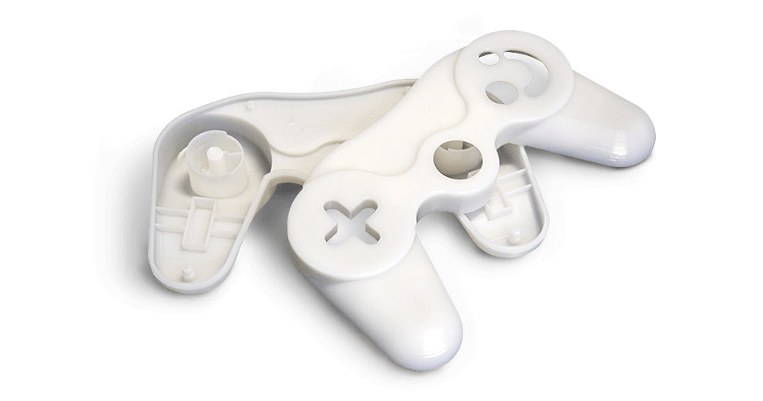
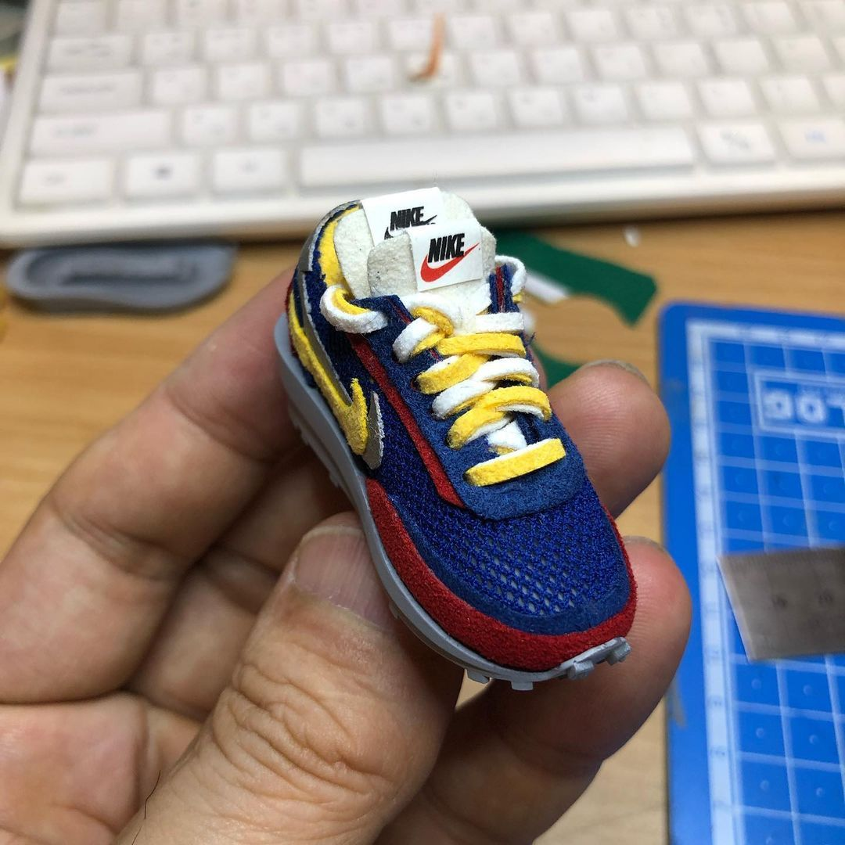
PROTOTYPE EXAMPLE - Miniatures

Slide 12
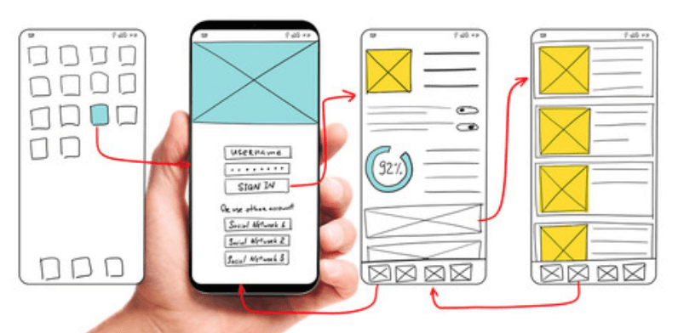
Prototype example:

Slide 13
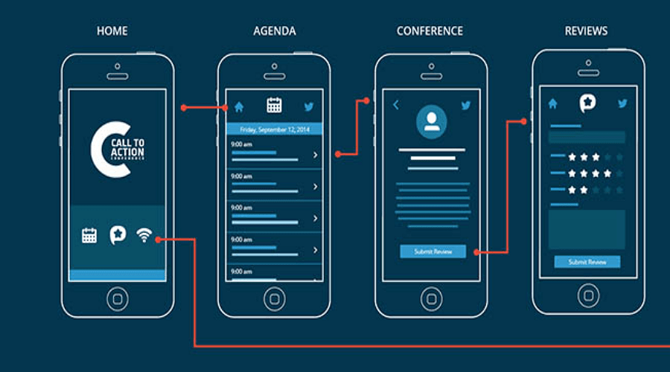
Notes:
https://www.getcloudapp.com/uses/product-demos

Slide 14
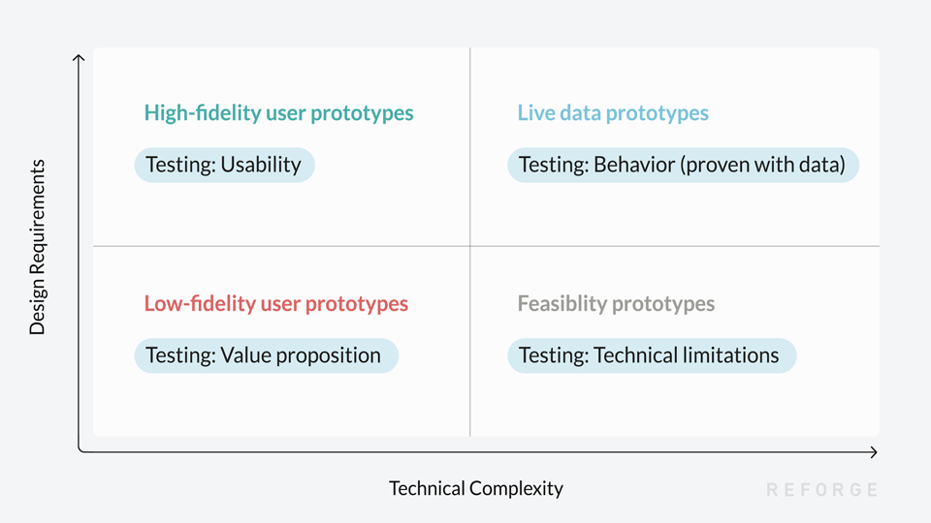
Types of prototype:
Notes:
https://www.reforge.com/brief/the-4-different-types-of-product-prototypes#2bDMnBcqV8uuNluG0DqtCg

Slide 15
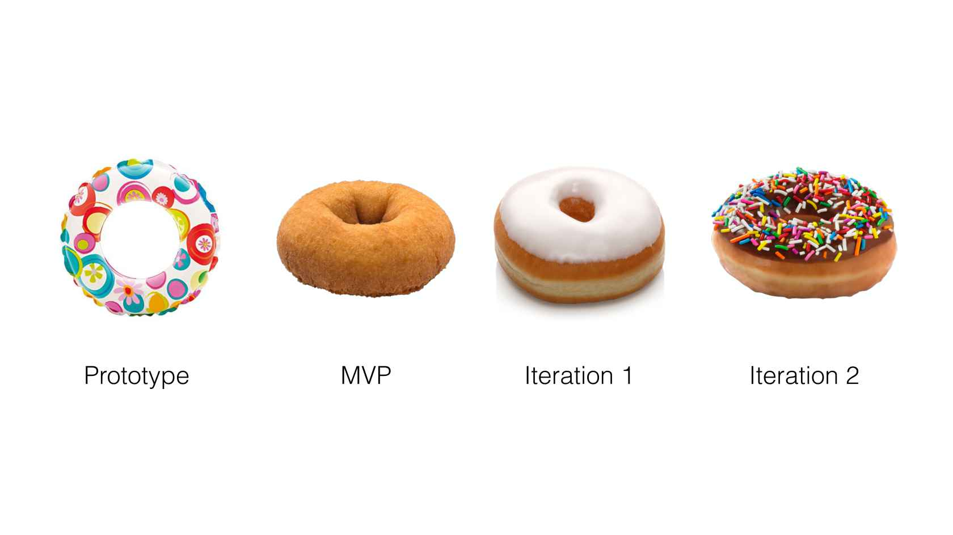
Be aware, you should aim for MVP, not for creating the actual product
Notes:
https://www.rcubedgroup.com/is-there-a-secret-low-risk-way-for-startups-to-deliver-mvps-on-the-cheap/

Slide 16
It’s time to pick up a focus.
Once you’ve decided to prototype, it’s time to pick up a focus. Figure out what you want to achieve and stay focus!
Is the prototype made for testing or for communication?
If for testing, would it be and exploratory or directed study?
What do you want to test, attitude, engagement, or behavioral metrics?
Do you have any hypotheses or assumptions?
Which part of the product do you want to collect feedback?

Slide 17
Test your Prototype: Share the prototype with the people you are designing it for and obtain feedback about what works and what doesn’t. Group Interview: Use a group interview to answer questions about your prototype. Co Creation Session: A co creation session sees people in the group not as interview subjects but as designers. Facilitate co creation by enabling people to actively redesign and make changes to the prototype One to one Interview Online tools

Slide 18
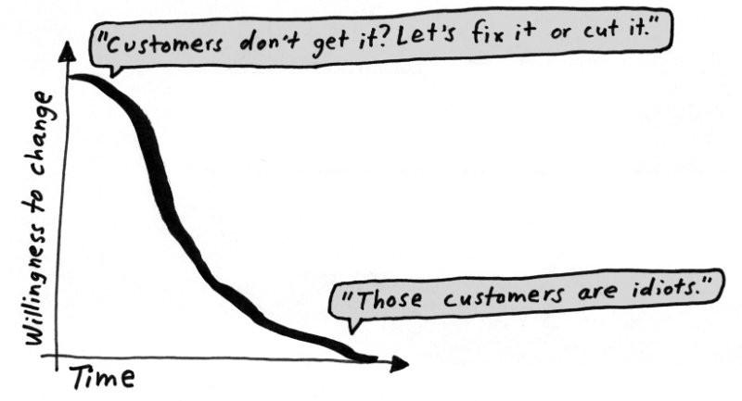
Notes:
https://medium.com/galleys/the-prototype-mindset-396c979a356f

Slide 19
Evaluate and Iterate
What did you find out?
Gather your findings: As soon as possible after testing, get down all of your findings including observations, facts, stories and hunches on paper. Use post it notes on a large board or paper.
Synthesize and analyze your findings: You can use Frameworks above to help organize all your feedback. Using frameworks such as 2x2 grids, diagrams or customer journeys will make you begin to see patterns in all of your findings.

Slide 20
Ideas and Iterations:
What did you find out?
Gather your findings: As soon as possible after testing, get down all of your findings including observations, facts, stories and hunches on paper. Use post it notes on a large board or paper.
Synthesize and analyze your findings: You can use Frameworks above to help organize all of your feedback. Using frameworks such as 2x2 grids, venn diagrams or customer journeys will make you begin to see patterns in all of your findings.

Slide 21
Try to sell the product (by using prototype) before you actually build it

