Slide 1
МODULE:
TOOLS AND METHODS FOR
ORGANIZATION AND
REALIZATION OF SUSTAINABLE DEVELOPMENT AND SOCIAL
ENTERPRISES

Slide 2
DECISION – MAKING AND SUSTAINABLE DEVELOPMENT

Slide 3
DEFINITIONS
Sustainable development
is defined as “development that meets the needs of the present without compromising the ability of future generations to meet their own needs.” The concept of needs goes beyond simply material needs and includes values, relationships, freedom to think, act, and participate, all amounting to sustainable living, morally, and spiritually
Decision – making
Trewatha & Newport defines decision making process as follows:, “Decision-making involves the selection of a course of action from among two or more possible alternatives in order to arrive at a solution for a given problem”.

Slide 4
Decision – making
Decision-making is an integral part of modern management.
Decision - making process can be regarded as check and balance system that keeps the organisation growing both in vertical and linear directions.
A decision is a choice between alternatives
Decision making is the process of choosing one alternative over the others.
Making good decisions should be a process. It is a process of identifying problems and resolving them, or of identifying opportunities and taking advantage of them.
The process is made up of two components:
Judgment – a process of evaluating alternatives
Choice – a process of selecting a specific alternative to implement

Slide 5
Decision – making Characteristics of Human Information Processors
Selective perception - Because human beings can handle only limited amounts of stimuli simultaneously, we all “choose” what we will attend to and what we will ignore.
The key to successful organizational decision making is to “select” the relevant information and ignore irrelevant information
Following characteristics influence judgment and choice processing, often in very negative ways. Knowing that they exist and how they work allows us to be more vigilant with how we process information and make choices—to the point of establishing decision support systems to minimize these human information processing problems.

Slide 6
Decision – making Characteristics of Human Information Processors
Framing - This refers to how a decision is oriented and organized. A typical dichotomy of “framing” is for a choice to be represented as a problem to solve versus an opportunity to take advantage of. Another is positive versus negative. Framing is important because different outcomes result depending upon how the decision is framed, even when the decision maker has the same information.
Escalation of commitment to a failing course of action - Failure to ignore sunk costs (investments that are already gone and cannot be recovered) and see that the original choice is not achieving--and will not achieve—the initial objectives. The “sunk cost” doesn’t have to be financial. It can be just personal effort and self-esteem that someone has invested in a course of action. To avoid admitting error or defeat, or humiliation, the decision maker continues to invest more and more in the original choice.

Slide 7
Risk propensity - The orientation of the decision maker to either seek risk or avoid it. While each of us has an individual risk propensity, all of us are typically risk seeking for gains and risk averse for losses. This means that if something has been working, we will continue to do more of the same even though the situation has changed. Coupled with selective perception, framing, and escalation of commitment, this phenomenon of choice can have dire consequences of overly conservative behavior to the point that we fail to be creative.
Hindsight bias - this is the inability of a decision maker to remember correctly the circumstances that existed prior to implementing a choice once action has been taken. You can recognize this behavior when someone says, “I KNEW that was going to happen!” This is a problem because we fail to learn from our decisions.

Slide 8
Over-confidence, complacency - Pilots know these two. Over-confidence is where we give ourselves credit for being more capable than we actually are, particularly with respect to risky situations. We take more risky actions than are objectively justifiable. Complacency is becoming more comfortable with a situation than is warranted by the level of risk that objectively exists (Kilbourne, 2006). Both of these can cause us to make poor choices.

Slide 9
Context Factors of Decision - Making
Certainty
Risk
Uncertainty
Ambiguity
Decision maker has specific goals and good information relevant to alternatives, but there is some risk associated with the outcomes of each alternative—but the risk can be assessed.
All information relevant to the decision is known or available to the decision maker, including specific goals, alternatives, and outcomes associated with each alternative action.
Decision maker has specific goals, but information about alternatives and outcomes of alternatives is incomplete.
The situation is so new or unclear that goals are vague, alternatives are difficult to specify, and outcomes of alternatives are unknown.

Slide 10
Context Factors of Decision – Making:
Given what we know about individual risk propensity, this context feature can have huge consequences to judgment and choice.
Urgency – how quickly do you have to decide
Importance – how much impact will the decision have
Life-span of Problem/Opportunity – how likely is the issue to go away on its own

Slide 11
Creating a decision – making process

Slide 12
Decision – making process 7 steps
There are many decision-making models. The following one is the one that many of the students will be familiar with.
Identify the problem. The first step is to recognize there is a problem and a decision must be made. Some people just react to problems, but good managers seek to understand the problem. Defining and clarifying the problem helps. Decision making is essentially a problem-solving process. This involves understanding the situation and trying to resolve it.
List alternatives. Managers need to develop a list of possible courses of action that will solve the problem. Managers must look for standard answers and also creative answers. The technique “brainstorming” is an example of creative thinking that can take place between a manager and the subordinates. In brainstorming, everyone comes up with as many alternatives as possible. A critical point about brainstorming sessions is that no criticism should be allowed. You want to foster a nurturing environment where everyone will feel like contributing. Shooting down an idea will stop the free flow of exchange.

Slide 13
Select the best alternative. In some models, the next step is evaluating your alternatives, but we are combining the evaluation with the selection. Evaluating is part of selecting. As part of the evaluation, you should list the potential effects of each choice. You should also weigh the advantages and disadvantages. Discuss those effects and make the decision based on what is best for the organization.
Implement the chosen alternative. Put the alternative into action. This is critical. All of your successful analysis won’t do any good if you are afraid to act. Whether the implementation is easy or hard, you must take action
Evaluate. Earlier we evaluated the alternatives, but now this final step means to evaluate the action. This is done with feedback. Collect the best feedback you can. If the problem is not resolved, a manager must go back through the process and look at other alternatives.

Slide 14
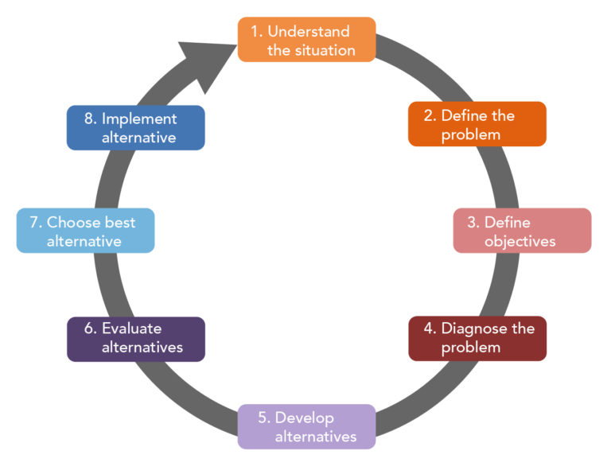
Steps in Decision – making process:

Slide 15
Example of decision – making process
Environmental decision making in the context of sustainable development – „theory“
In simple terms, environmental decision making is taken to mean decision making that has an effect on our environment, however it is defined. If adopting a broad definition of environment, it could be said that nearly all decision making comes into this category.
So why do we need to talk about environmental decision making at all rather than simply decision making? It is because there is increasing recognition that many of the decisions we make and actions we take, both individually and in groups, influence our environment and yet economic and political considerations often dominate in a way that seems to exclude environmental considerations. By environmental in this context, I mean that which surrounds and affects us including our physical and biological life-support base alongside social, economic, cultural, political and institutional factors.
We are mainly taking into consideration those decisions which have local dimensions but are related to worldwide environmental issues, and where individuals and groups have choices, they can make to maximize positive environmental outcomes, improve our environment and limit detrimental effects.

Slide 16
Example of decision – making process
Examples include our use of transport, making consumer decisions, planning new or improved developments and managing natural resources.
Whilst accepting that there are widely divergent views about what environmental decision making implies, we believe that the main challenge seems to be not one of replacing economic, political and social considerations, which currently prevail in much decision making, with an environmental agenda but one of bringing these factors together in every decision-making process.
A note of caution is needed however: singling out one area for special attention might on occasions have the effect of separation rather than integration. In order that we might more fully explore this integration of environment with the other factors prevalent in decision making, we perhaps need to begin by taking the position that we cannot afford to exclude environmental concerns if we are to meet basic human needs both now and in the future.
This is based on an assumption that the rate at which we are using some of our natural resources (such as oil, water or land) and polluting air, soil, fresh waters and oceans is unsustainable. Hence, we will consider environmental decision making in the context of sustainable development and will now go on to explore what that means.

Slide 17
Some more reading and sources:
https://www.gocivilairpatrol.com/media/cms/Lesson_Plan_35__Planning_and_Decisi_5A5628811B98A.pdf
https://courses.lumenlearning.com/wm-organizationalbehavior/chapter/the-decision-making-process/
https://www.umassd.edu/fycm/decision-making/process/
https://www.tutorialspoint.com/management_concepts/decision_making_process.htm
https://www.lucidchart.com/blog/decision-making-process-steps
https://the-happy-manager.com/tip/steps-in-decision-making/
https://www.open.edu/openlearn/nature-environment/introducing-environmental-decision-making/content-section-2.4
https://www.open.edu/openlearn/nature-environment/introducing-environmental-decision-making/content-section-2.1 (all chapter 2)
https://www.eolss.net/sample-chapters/C13/E1-46B-02.pdf

