Slide 1
Module: Sustainable development and sustainable communities
(The role in social entepreniship)

Slide 2
TAKE ACTION!
MEASURES TO REDUCE CO₂ EMISSIONS

Slide 3
REDUCING CARBON EMISSON:
An Emissions Trading System for industry https://www.europarl.europa.eu/news/en/headlines/society/20180305STO99003/reducing-carbon-emissions-eu-targets-and-measures
The EU's Emissions Trading System (ETS) aims to reduce the industry's carbon emissions by obliging companies to hold a permit for each tonne of CO2 they emit. Companies have to buy them through auctions. There are some incentives to boost innovation in the sector. The European Emissions Trading System is the world's first major carbon market and remains the largest one. It regulates about 40% of total EU greenhouse gas emissions and covers approximately 11,000 power stations and manufacturing plants in the EU. The goal is to reduce emissions by 43% compared to 2005. Find out more about how the EU’s Emissions Trading System works and how it is currently being reformed.

Slide 4
REDUCING CARBON EMISSON
Tackling carbon emissions from other sectors https://www.europarl.europa.eu/news/en/headlines/society/20180305STO99003/reducing-carbon-emissions-eu-targets-and-measures
Sectors not covered by the Emissions Trading System – such as transport, agriculture, buildings and waste management – still account for approximately 60% of the EU’s overall emissions. Emissions from these sectors will be cut by 30% by 2030 compared to 2005. This will be done through agreed national emission targets which are calculated based on countries' gross domestic product per capita. Lower-income EU countries will be provided with support. Find out member states’ targets and how less wealthier EU countries will be supported.

Slide 5
REDUCING CARBON EMISSON
Managing forests for climate change https://www.europarl.europa.eu/news/en/headlines/society/20180305STO99003/reducing-carbon-emissions-eu-targets-and-measures
EU forests absorb the equivalent of 8.9% of total EU greenhouse gas emissions each year. The EU wants to use this power to fight climate change. New legislation aims to prevent emissions caused by deforestation and oblige each EU country to compensate changes in land use, which lead to emissions of CO2, by better managing or increasing their forests. Check out our infographic to learn how the EU uses forests to offset carbon emissions.

Slide 6
REDUCING CARBON EMISSON
Reducing car emissions https://www.europarl.europa.eu/news/en/headlines/society/20180305STO99003/reducing-carbon-emissions-eu-targets-and-measures
Cars and vans produce 15% of the EU’s CO2 emissions. The EU has adopted legislation to toughen car emissions standards, and Parliament is also calling for measures to facilitate the shift to electric and hybrid vehicles. Learn more about the new CO2 targets for cars.
Find out MORE:
https://www.europarl.europa.eu/news/en/headlines/priorities/climate-change/20180703STO07123/climate-change-in-europe-facts-and-figures
https://www.europarl.europa.eu/news/en/headlines/priorities/climate-change

Slide 7
What can I do?

Slide 8
Reduce CO₂ emissions while saving energy
Replace old windows with new ones, double glazed, and save in the household up to 180 kg of CO₂ per year.
Replacing windows otherwise requires a small advance investment, which will undoubtedly be in the long run interest.

Slide 9
Reduce CO₂ emissions and contribute to environmental protection
Turn off five 60-watt light bulbs at home when you don’t you need and save about 220 kg of CO₂ per year.
The savings count if we turn off five 60-watt watches light bulbs that would otherwise burn 4 hours a day each day of the year. The result will also be visible on the electricity bill!

Slide 10
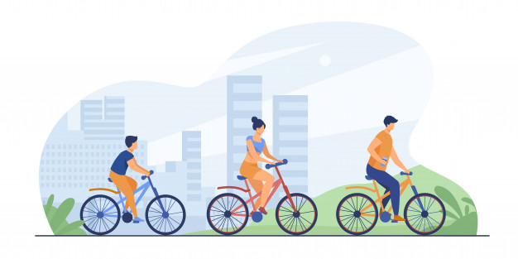
Reduce CO₂ emissions and negative influence to the climate change
Instead of a short drive, sit down per bike and save about 240 kg of CO2 per year.
The savings apply if e.g. to a job or school that is 3 km away from home, you use a bicycle. You also contribute a lot if you use public transport.

Slide 11
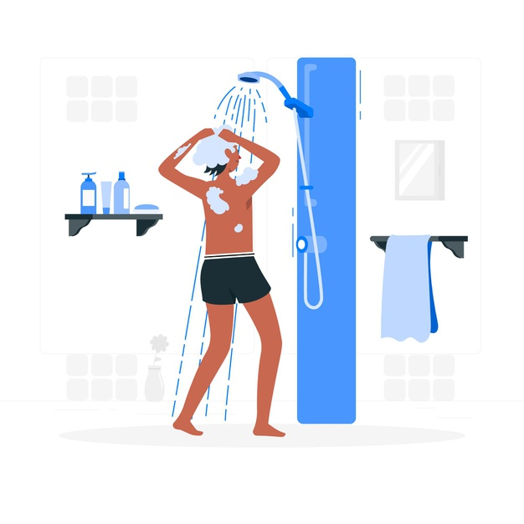
Reduce CO₂ emissions and thus energy costs
Install a shower with a low flow head and on saves 159 kg of CO₂ per year.
When showering with the installation of low-flow heads reduce energy and water consumption. Take it a step further and shower less time. Every minute you take a shower with a regular shower, namely, you consume more than 9 liters of water.

Slide 12
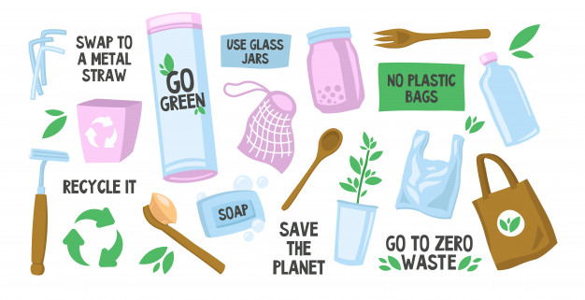
Reduce CO₂ emissions and be proud of it
Try to reuse and fix things, instead of replacing them immediately with new ones. This can save about 250 kg of CO₂ per year.
Just using a cleaning sponge instead kitchen paper can save 5 kg of CO2 per year.

Slide 13
To test your knowledge and determine the actual amount of 1 gram CO₂ emissions, you need to fill the missing steps in the cube ( part of the activity) and assemble it.

Slide 14
Climate change is one of humanity's major challenges today.
However, we do not see the cause of the problem and usually what we do not see in most cases does not exist for us.
SOLUTION!
Saving energy and efficent use of energy are the most efficient steps to reduce CO₂ emissions

Slide 15
REMEMBER!
The purest energy is that which we do not use!

