Slide 1
Module: Sustainable development and sustainable communities
(The role in social entepreniship)

Slide 2
2030 AGENDA FOR SUSTAINABLE DEVELOPMENT

Slide 3
SUSTAINABLE DEVELOPMENT GOALS (SDGS) 2030
Sourc: khttps://www.un.org/sustainabledevelopment/

Slide 4
The 2030 Agenda for Sustainable Development, adopted by all United Nations Member States in 2015, provides a shared blueprint for peace and prosperity for people and the planet, now and into the future. At its heart are the 17 Sustainable Development Goals (SDGs) and their related 169 targets, which are an urgent call for action by all countries - developed and developing - in a global partnership. They recognize that ending poverty and other deprivations must go hand-in-hand with strategies that improve health and education, reduce inequality, and spur economic growth – all while tackling climate change and working to preserve our oceans and forests.(https://sdgs.un.org/goals)

Slide 5
Three Dimensions of Sustainable Development
Sustainable development has been defined as development that meets the needs of the present without compromising the ability of future generations to meet their own needs.
For sustainable development to be achieved, it is crucial to harmonize three core elements: economic growth, social inclusion and environmental protection.

Slide 6
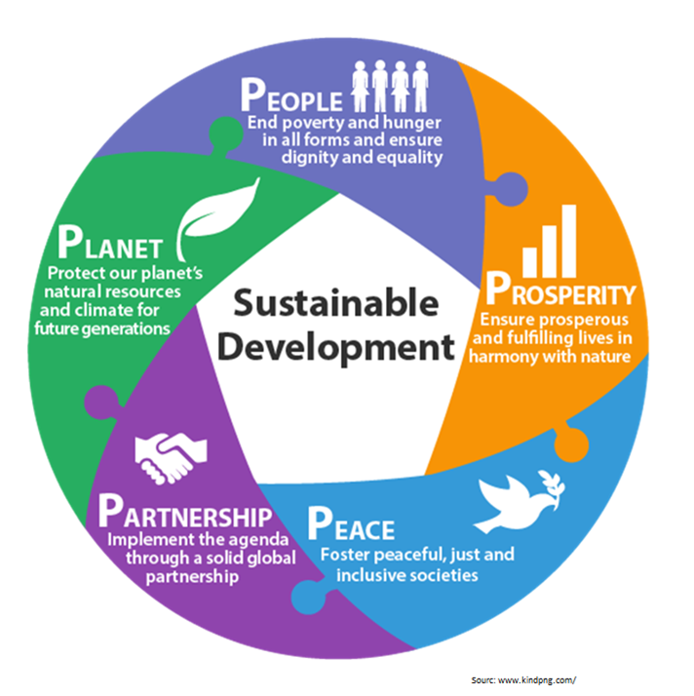
What are the elements underpinning the Sustainable Development Goals?
Another Way to Look at SDGs
The Goals and targets will stimulate action in areas of critical importance: people, planet, prosperity, peace and partnership.
PEOPLE - to end poverty and hunger, in all their forms and dimensions, and to ensure that all human beings can fulfil their potential in dignity and equality and in a healthy environment. (Goal 1, 2, 3, 4, 5 and 6)
PROSPERITY - to ensure that all human beings can enjoy prosperous and fulfilling lives and that economic, social and technological progress occurs in harmony with nature. (Goal 7, 8, 9, 10 and 11)
PLANET - to protect the planet from degradation, including through sustainable consumption and production, sustainably managing its natural resources and taking urgent action on climate change, so that it can support the needs of the present and future generations. (Goal 12, 13, 14 and 15)
PEACE - to foster peaceful, just and inclusive societies free from fear and violence. There can be no sustainable development without peace and no peace without sustainable development. (Goal 16)
PARTNERSHIP - to mobilize the means required to implement this agenda through a revitalised global partnership for sustainable development, based on a spirit of strengthened global solidarity, focused in particular on the needs of the poorest and most vulnerable and with the participation of all countries, all stakeholders and all people. (Goal 17)

Slide 7
Goal 1: End poverty in all its forms everywhere
More than 700 million people, or 10 per cent of the world population, still live in extreme poverty today, struggling to fulfil the most basic needs like health, education, and access to water and sanitation, to name a few. The majority of people living on less than $1.90 a day live in sub-Saharan Africa.

Slide 8
Goal 2: End hunger, achieve food security and improved nutrition and promote sustainable agriculture
Current estimates are that nearly 690 million people are hungry, or 8.9 percent of the world population – up by 10 million people in one year and by nearly 60 million in five years.

Slide 9
Goal 3: Ensure healthy lives and promote well-being for all at all ages
Significant strides have been made in increasing life expectancy and reducing some of the common killers associated with child and maternal mortality.
Link to the Goal 3 targets (quiz help): https://www.un.org/sustainabledevelopment/health/

Slide 10
Goal 4: Ensure inclusive and quality education for all and promote lifelong learning
Obtaining a quality education is the foundation to improving people’s lives and sustainable development.
Major progress has been made towards increasing access to education at all levels and increasing enrolment rates in schools particularly for women and girls.
Basic literacy skills have improved tremendously, yet bolder efforts are needed to make even greater strides for achieving universal education goals.

Slide 11
Goal 5: Achieve gender equality and empower all women and girls
Gender equality is not only a fundamental human right, but a necessary foundation for a peaceful, prosperous and sustainable world.
Providing women and girls with equal access to education, health care, decent work, and representation in political and economic decision-making processes will fuel sustainable economies and benefit societies and humanity at large.

Slide 12
Goal 6: Ensure access to water and sanitation for all
Clean, accessible water for all is an essential part of the world we want to live in. There is sufficient fresh water on the planet to achieve this. But due to bad economics or poor infrastructure, every year millions of people, most of them children, die from diseases associated with inadequate water supply, sanitation and hygiene.

Slide 13
Goal 7: Ensure access to affordable, reliable, sustainable and modern energy for all
Energy is central to nearly every major challenge and opportunity the world faces today. Be it for jobs, security, climate change, food production or increasing incomes, access to energy for all is essential.
Sustainable energy is opportunity – it transforms lives, economies and the planet.

Slide 14
Goal 8: Promote inclusive and sustainable economic growth, employment and decent work for all
Sustained and inclusive economic growth can drive progress, create decent jobs for all and improve living standards.

Slide 15
Goal 9: Build resilient infrastructure, promote sustainable industrialization and foster innovation
Investments in infrastructure – transport, irrigation, energy and information and communication technology – are crucial to achieving sustainable development and empowering communities in many countries. It has long been recognized that growth in productivity and incomes, and improvements in health and education outcomes require investment in infrastructure.

Slide 16
Goal 10: Reduce inequality within and among countries
Reducing inequalities and ensuring no one is left behind are integral to achieving the Sustainable Development Goals.

Slide 17
Goal 11: Make cities inclusive, safe, resilient and sustainable
The world is becoming increasingly urbanized. Since 2007, more than half the world’s population has been living in cities, and that share is projected to rise to 60 per cent by 2030.

Slide 18
Goal 12: Ensure sustainable consumption and production patterns
Sustainable consumption and production is about doing more and better with less. It is also about decoupling economic growth from environmental degradation, increasing resource efficiency and promoting sustainable lifestyles.

Slide 19
Goal 13: Take urgent action to combat climate change and its impacts
2019 was the second warmest year on record and the end of the warmest decade (2010- 2019) ever recorded.
Climate change is affecting every country on every continent. It is disrupting national economies and affecting lives. Weather patterns are changing, sea levels are rising, and weather events are becoming more extreme.

Slide 20
Goal 14: Conserve and sustainably use the oceans, seas and marine resources
The ocean drives global systems that make the Earth habitable for humankind. Our rainwater, drinking water, weather, climate, coastlines, much of our food, and even the oxygen in the air we breathe, are all ultimately provided and regulated by the sea.

Slide 21
Goal 15: Sustainably manage forests, combat desertification, halt and reverse land degradation, halt biodiversity loss
Nature is critical to our survival: nature provides us with our oxygen, regulates our weather patterns, pollinates our crops, produces our food, feed and fibre. But it is under increasing stress. Human activity has altered almost 75 per cent of the earth’s surface, squeezing wildlife and nature into an ever-smaller corner of the planet.

Slide 22
Goal 16: Promote just, peaceful and inclusive societies
Goal 16 of the Sustainable Development Goals is dedicated to the promotion of peaceful and inclusive societies for sustainable development, the provision of access to justice for all, and building effective, accountable institutions at all levels.

Slide 23
Goal 17: Revitalize the global partnership for sustainable development
A successful sustainable development agenda requires partnerships between governments, the private sector and civil society. These inclusive partnerships built upon principles and values, a shared vision, and shared goals that place people and the planet at the center, are needed at the global, regional, national and local level.

Slide 24
Suorc: https://www.azquotes.com/quotes/topics/sustainable-development.html

Slide 25
References for the entire presentation: https://www.un.org/sustainabledevelopment/poverty/
Thank you for your attention!

