Slide 1
Module: Sustainable development and sustainable communities
(The role in social entepreniship)

Slide 2
Introduction: Sustainable development and sustainable communities (The role in social entepreniship)

Slide 3
Sustainable development/ Sustainable communities
Sustainable development is important for community, because with understanding of sustainable development you achieve sustainable community.
Making sustainable community means trying to use renewable sources without giving any harm to environment and giving bad impact later.

Slide 4
Sustainable development
Sustainable development is defined as “development that meets the needs of the present without compromising the ability of future generations to meet their own needs.” The concept of needs goes beyond simply material needs and includes values, relationships, freedom to think, act, and participate, all amounting to sustainable living, morally, and spiritually.

Slide 5
Sustainable communities
Sustainable communities have various definitions, but in essence refers to communities planned, built, or modified to promote sustainable living. Sustainable communities tend to focus on environmental and economic sustainability, urban infrastructure, social equity, and municipal government. The term is sometimes used synonymously with "green cities," "eco-communities," "liveable cities" and "sustainable cities."

Slide 6
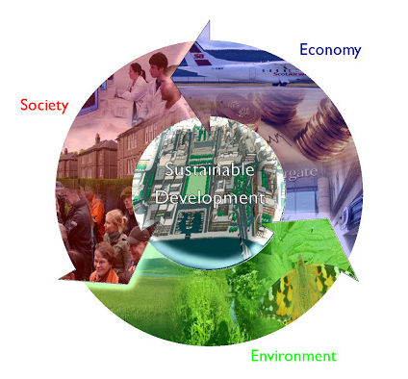
Three pillars to consider:
There are three pillars that need to be considered for considering sustainability and social entrepreneurship:
Photo: http://hellemanworld.blogspot.com/2012/04/global-warming-and-economic.html

Slide 7
Social entrepreneurship
Social entrepreneurship is all about recognizing the social problems and achieving a social change by employing entrepreneurial principles, processes and operations. Along with social problems, social entrepreneurship also focuses on environmental problems. Social entrepreneurship is best understood as a multidimensional and dynamic construct moving across various intersection points between public, private and social sectors.
Photo: http://hellemanworld.blogspot.com/2012/04/global-warming-and-economic.html

Slide 8
Social entrepreneurship
Social entrepreneurship is all about recognizing the social problems and achieving a social change by employing entrepreneurial principles, processes and operations. Along with social problems, social entrepreneurship also focuses on environmental problems. Social entrepreneurship is best understood as a multidimensional and dynamic construct moving across various intersection points between public, private and social sectors.

Slide 9
Sustainable development and climate changes
In the 2030 Agenda for Sustainable Development, Member States express their commitment to protect the planet from degradation and take urgent action on climate change. The Agenda also identifies, in its paragraph 14, climate change as “one of the greatest challenges of our time” and worries about “its adverse impacts undermine the ability of all countries to achieve sustainable development. Increases in global temperature, sea level rise, ocean acidification and other climate change impacts are seriously affecting coastal areas and low-lying coastal countries, including many least developed countries and Small Island Developing States. The survival of many societies, and of the biological support systems of the planet, is at risk”.

Slide 10
Sustainable development and social entrepreneurship
Additionally, both are interested in helping society progress in a sustainable way, since, among other issues, it allows them to differentiate their products and enter new markets, as indicated above.
In this sense, it is interesting to know which of the two would have a more positive effect on sustainable development.
Presumably, it would be sustainable entrepreneurship, since it would be more concerned with social and environmental issues than with profit achievement.
Therefore, innovations and entrepreneurship play an essential role in stimulating sustainable development

Slide 11
