Slide 1
Module: Resource Efficient and Cleaner Production

Slide 2
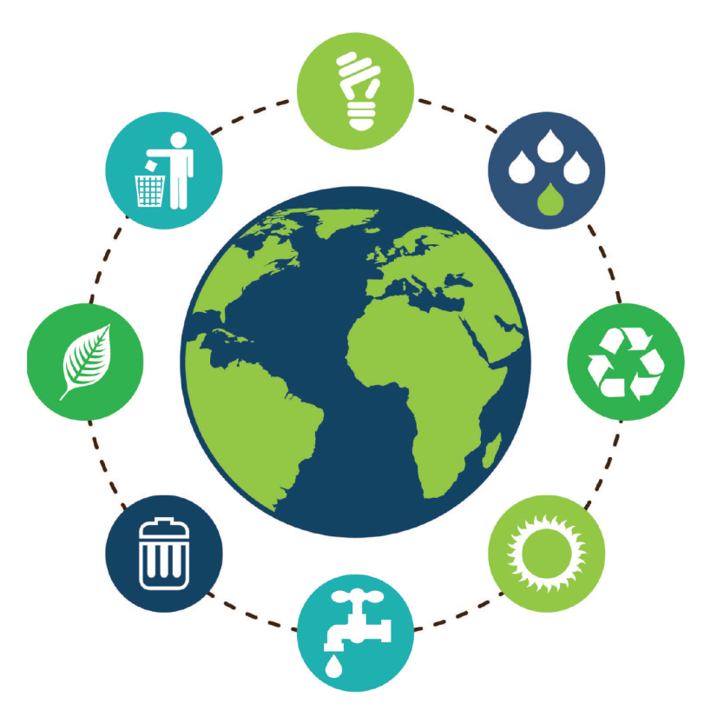
Methodology of the concept of Resource Efficient and Cleaner Production

Slide 3
The concept of cleaner production is based on the so-called Deming циклус, i.e., Plan- Do- Check- Act (PDCA)
Plan-do-check-take over activity, in modern time modified into Commit-plan-do-check (copdch)
This system is a basis for all standards for management within the International organization of standardization (ISO), for which if an entity integrates a usage of standards, such as ISO 9001, ISO 14001, ISO 45001 (counterpart of the British standard BS OHSAS 18001) or ISO 50001, that entity is halfway through the implementation and the concept of more efficiency regarding resources and cleaner manufacturing.

Slide 4
More precisely analyzed, through a continuous implementation of the concept Resource Efficient and Cleaner Production (RECP), it should be contributed to:
Efficiency in manufacturing – through optimizing of a productive and efficient implementation of the natural resources (materials, energy, water) in all stadiums of the manufacturing cycle;
Managing with the environment – through minimizing of the various influences on the industrial manufacturing systems on nature and in general, on the environment;
Humanity development – through minimizing of risks that would stem from industrial manufacturing systems of people and their municipalities, as well as ensuring support in terms of their continuous development.

Slide 5
Practically, every manufacturing entity (industrial) that decides to implement the RECP concept, should also enable and realize the manufacturing in these terms:
As clean as possible
With less resources as possible.
Both aspects mean that all operations comprising the manufacturing process should be in a cleaner, safer and more sustainable way, so that less waste is generated or to avoid creating waste more and more.
Set in such a way, the concept of RECP:
Reduces the needs for non-renewable resources, through recycling and repetitive use of products and resources,
Minimizing creating of waste with which the final outcome of synergy from both actions lessens the anthropogenic influences on the environment

Slide 6
Elements of the concept of Resource Efficient and Cleaner Production:
Basic elements of the concept of cleaner manufacturing are:
Collecting data- Acknowledging of mass and energy balances, flows of materials and energy, costs and safety. One of the most basic and important steps is the suitable description of the current state (status quo), but that often is time consuming.
Reflection and thinking: Where and why do we make waste? After collecting, the data is analyzed and evaluated according to the principles of RECP concept, i.e., it helps companies to help themselves independently.
Generating options in terms of realizing the RECP concept. Having the analysis as a starting point, options are generated for realization of the RECP concept.

Slide 7
Also, there will appear, be recognized or suggested new and/or well-known options that through good and aware work (household and rules), through modification of the processes, change in the organizational schemes, internal and external recycling, etc., will strive to reduce the using of resources at their source level and reduce the amounts of waste materials at the very production phase.
4. Feasibility analysis. For the chosen options, the feasibility study will do an analysis regarding economic, technical and feasibility aspects, and in terms of reduces influences on the environment.
5. Implementation. In this phase are implemented the options that stemmed from the course of implementation of RECP concept. The elements (steps from 1 to 4) can be done prior, but if the benefits and feasibility stemming from the implementation of an option are obvious, the options are often implemented directly, without a detailed analysis of the feasibility.
6. Control and continuation. Probably, the most important and challenging aspect of RECP concept is the establishing of a systematic action for current improvement. In this case, with setting of new goals and targets, and to ensure their continuous implementation are also used to the tools for controlling from aspect of protection of the environment.

Slide 8
Dedication by upper management
Organizing of the team for implementing RECP
Completing, preparation of basic information, organizational structure, organizational scheme of the process
Recognizing barriers and solutions regarding the grading process
Planning and organization
Initial (preliminary) grade
Detailed grade
Analysis of feasibility
Implementation and continuous implementation
Reviewing the management, evaluation and documenting of the project(s), reevaluating
Continuous implementing
Preparation of action plan, controlling of the project implementation
Initial walk through the process, eco-map, checklist for implementing of RECP
Preparation of block diagram during the process
Preparation of basic data for consumption and production, analysis of input and output, register of related legislation, critical indicators of performance.
Summarizing of the initial review, deciding on the focus for the detailed grade
Preparation of list for "easy solutions for improvement" and their implementation
Preparation of list for "easy solutions for improvement" and their implementation
Interfunctional tasks
Implementing evaluation regarding economic, societal, and aspects of the environment
Choice of options, documenting of the phases for grade
- Grade for the needs of a training
- Documenting
Energetic and material balances
Conducting an analysis for diagnosis for reasons
Generating (creating) list of options for RECP

Slide 9
Phases of implementation of the concept for Resource Efficient and Cleaner Production (RECP)
The phases of implementing the concept of Resource Efficient and Cleaner Production (RECP), are schematically presented on the picture:
1
Commitment phase (of upper management and all employees)
2
Planning and organizing phase
3
Doing and implementation phase
4
Checking phase

Slide 10
Dedication phase. Through implementation of any managing system, the first and most essential phase is ensuring dedication of the top management in the company / entity where the RECP concept will be used.
That is because the dedication of the top management will stem the dedication of all personnel in general in all levels of the hierarchy. Additionally, in this phase are implemented the following subphases:
recognizing and defining of the implementation team for the concept RECP;
defining of the scope and physical limits of the system to be analyzed;
recognizing of the barriers and trigger forces in the implementation of the concept RECP.

Slide 11
2. Phases of planning and organization. This phase should prevent access to some unchecked or unjustified options that at first seem like they go in the direction of the example of the concept RECP.
More specifically, in this phase are implemented the following subphases:
Dedication phase
Planning and organization phase
Implementation phase
Checkup phase
Implementing of an initial evaluation;
Implementing of a detailed evaluation
Implementing of a feasibility analysis

Slide 12
3. Implementation phase. More specifically, in this phase are implemented the following subphases:
Preparation of action plan for implementation of the RECP concept;
Preparation of a control plan for implementing the projects (options) recognized within the previous phases;
Choice and implementation of suitable (and) technology in accordance with the RECP concept, applicable for specific states in the reviewed entity/company, etc.
Depiction of the benefits of the implementation of the chosen options, from aspect of the influence on the environment, as well as the economic and societal benefits;
Preparation of a summary report for the predicted measures covered with the general implementation of the RECP concept in the suitable entity.

Slide 13
4. Checkup phase. More specifically, in this phase are implemented the following:
Review of the management (lower and higher levels), and also on the whole system;
System evaluation, and a complete realization of the projects within the concept (RECP);
Evaluation of the system functioning through a review on the complete project documentation and the summary event of the predicted measures covered with the overall implementation of the RECP concept in the suitable entity;
Repeated reevaluation.

Slide 14
On the picture below are given the main steps during implementation of the RECP concept that stem from the defined protocol and phases of implementation of the process of RECP, such as:
Planning and organization,
Preliminary evaluation,
Evaluation,
Generating ideas – alternative solutions,
Feasibility study,
Implementation, control.

Slide 15
START OF THE PROGRAMME:
- The management of the company supports the project
- Forming of a work group
- Defining of the project goals
- Overcoming obstacles
- Preliminary estimations
PLANNING AND ORGANIZATION
MAIN STEPS:
DIAGNOSIS - ESTIMATION
Choice and determining
of new goals, evaluating
of the implemented
solutions
- Collecting data
- Forming of waste
- Defining of alternatives
Interphasic report
ALTERNATIVES - GENERATING IDEAS
- Technical grading
- Economic grading
- Choice of alternatives for implementation
Final report
Repeating of the action
IMPLEMENTATION
- Project presentation
- Equipment installation
- Program continuation
SUCCESSFULLY REALIZED PROJECT

Slide 16
Sources used:
dr. Anita Grozdanov, regular professor; manual for implementing of a training for sustainability advisor, Skopje 2018
https://ecologic.mk/the-manual-for-development-%d0%b0-training-advisor-of-sustainable-development/

