Slide 1
Module: Еco Design

Slide 2
Eco data

Slide 3
Eco-design is based on eco-data that are needed for eco-design of a new product.
A basic eco-data in eco-design is the built-in energy for producing 1 kilogram of material.
Eco attributes of materials are defined eco-properties that should be followed for the eco-design.

Slide 5
ECO ATTRIBUTES
In the first group are data referring to:
Sources of materials,
Raw material base,
Speed of usage.
The annual world production shows the mass of materials extracted from natural sources, ore and minerals, expressed in tons of metal/or other engineering material. The reserves are the dimensions of economically-returnable raw materials out of which other materials are extracted or received.

Slide 6
The second group of data are eco-properties of the manufacturing of materials:
Built-in energy of primary manufacturing, [MJ/kg]
CO2 imprint in primary manufacturing, [kg/kg],
Usage of water, [l/kg],
Eco-indicator, [milipoint/kg].
Besides the usage of certain technologies, the sustainable design in managing waters is also important in the proper concept implementation.
Among these main concepts is the fact that normally in developed countries – 100% of the usable water, not exclusively drinkable, has a drinking water quality.
This concept is for making a difference between the water quality for different goals, named “suitable for a certain goal”.

Slide 7
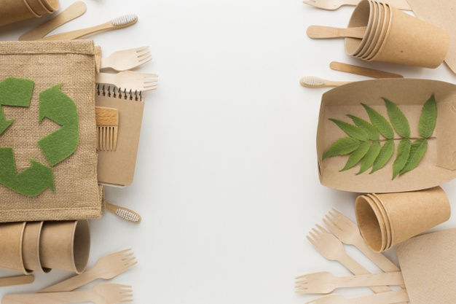
General principles of eco design:
а) Materials with a minor effect: chosen are those non-toxic, sustainably-made or recycled materials that seek not much energy for processing.
b) Energy efficiency: used are the manufacturing processes and from them products are made that seek not much energy.
c) Emotionally-sustainable design: reducing of the expenditure and waste of resources through increasing of the sustainability between the relations of people and products, through design.
d) Design for reusing and recycling: “products, processes and systems must be designed for execution in a commercial, closed lifecycle”.
e) Designer goal is a Permanent longevity, not immortality.
f) Material versatility in multicomponent products should be minimized in order to promote disassembling and retaining of the value.
g) Biomimicry: redesigning of industrial systems in biological lines…enabling continuous usage of materials in continually closed cycles.

Slide 8
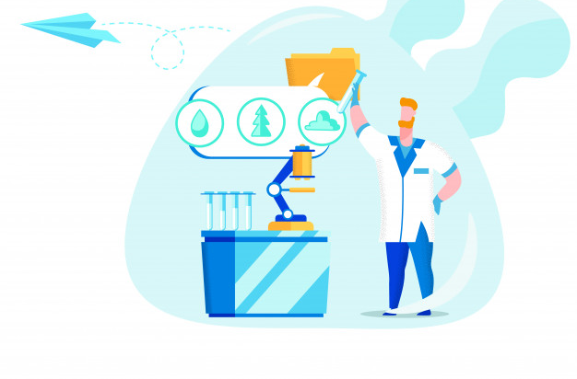
ECO AUDIT
Eco-audit presents a fast initial grade.
It identifies the phases of the lifecycle of materials, manufacturing, transport, usage, deposition of waste – seeking the most amount of energy and creating the most CO2 imprint.
Main goal of the eco-audit is to make a comparison providing fast usage of alternative solutions.

Slide 9
ECO AUDIT
Eco-audit gives a grade based on:
1. Analysis of all entries
2. Analysis of all phases of the lifecycle of one product/process
3. Comparison of other alternative choices

Slide 10
ECO AUDIT
Eco-audit through analysis of the consumed energy covers 5 steps:
1. Analysis of materials upon the entry (Built-in energy for each component)
2. Manufacturing (Processing energy and CO2 per unit mass for each material)
3. Transport (Consumed energy for transport of products to the point of sale)
4. Phase of usage (static/dynamic built-in energy)
5. Postponing until the end of the service life

Slide 12
ECO DESIGN is the philosophy of designing physical objects, the built environment, and services to comply with the principles of ecological sustainability.
2
+
https://www.youtube.com/watch?v=8r2BziT435A&feature=emb_logo

Slide 13
USED RESOURCES
2
+
Dr. Anita Grozdanov, regular professor (2019), Manual for implementing a training for “Sustainability advisor”
https://wegate.eu/start/market-access-operations/emas-eco-management-and-audit-scheme-certification
https://www.youtube.com/watch?v=8r2BziT435A&feature=emb_logo
https://en.wikipedia.org/wiki/Sustainable_design

