Slide 1
Module: Еco Design

Slide 2
Analysis of the life cycle of materials and their influence on the environment

Slide 3
Why LCA?
Ensures the best frame for evaluating the influence of one product;
It is used intensively in the industry for analysis and avoiding of all negative influences on the environment;
LCA improves the competition of the company;
It is used in decision making in the industry design.

Slide 5
WHAT IS INCLUDED IN LCA?
LCA is a technique for evaluating the aspects of the environment and potential influences linked to the products, including:
Creating a list of relevant inputs and outputs of the manufacturing system/cycle;
Evaluation of the potential influences on the environment of these inputs and outputs;
Interpreting the results of the analysis of the list for input/output.

Slide 7
Key characteristics of LCA
The LCA researches should systematically and adequately address the aspects of the environment from the manufacturing systems, from raw materials, to final ejection/deposition;
The depth of the details and the timeframe by LCA research can vary largely, depending on the definition of the goal and scope;
The scope, assumptions, description of the quality of information, methodologies and conclusions (outputs) of the LCA researches should be transparent;
Depending on the needs of LCA research, it is needed to make certain preparations respectfully to the credibility and privacy.

Slide 8
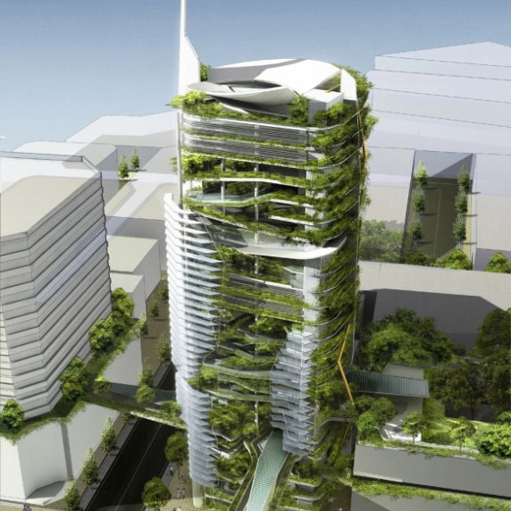
Key characteristics of LCA
The LCA method should succumb to the conclusions of the new scientific achievements and improvements in “state-of-the-art” of technology;
• In the LCA research are used special requirements too that are used for comparative proofs which are presented to the public;
• There are no scientific bases for reducing the LCA results toward a more all-including result or number;

Slide 9
PHASES of LCA
Receiving of raw materials;
2. Manufacturing;
3. Usage;
4. Recycling/deposition
5. Transporting.

Slide 10
TOOLS:
Detailed LCA tools – focused on the materials, components and processes. It uses mainly a selection of materials and procedures that enable optimizing of the manufacturing process.
Design tools
Design tools- Focused on the usage of a singular indicator for analysis of the overall influence.
LCA CAD
LCA CAD tools – Integrating tools that read information for the materials of the CAD drawings (it is considered a hybrid tool since it includes data of various origins).
Green product guide
Green product guides and checklists – These are quality-type guides for the products and processes that should be analyzed.
Building assessment schemes – This tool is most often used for analysis of the constructive sector or constructions in a certain scheme.
Embodied energy tools – This is a software tool, used for calculation of the ecological parameters, especially important for choosing materials and their prioritizing.

Slide 12
A step by step approach is used to carry out a successful LCA?
Forming an LCA team
An LCA team must be assembled first, as tasks will be assigned to individual team members. The LCA team will agree the goal and scope and project plan, monitor progress and finally review and implement the LCA results.
Goal and scope definition
LCA milestones must be defined by the LCA team (for example, dates for the completion of goal and scope definition, data collection etc). As the project progresses, the team will monitor these milestones against the overall project plan that has been set.
Inventory analysis
The main issue that must be taken into account when selecting the personnel to carry out the LCA is their knowledge of the product systems under study. Lack of sufficient knowledge regarding LCA can be addressed through training during briefing meetings .

Slide 13
Initial meeting
Participants must be kept informed about the goal of the study and the LCA process that will be carried out within the company.
Progress monitoring
The LCA management team should monitor the progress of the project, for example, how it is conforming to the objectives set at the start. Any significant problems that occur during the LCA process must be addressed. All energy and material inputs, output streams and emissions must be carefully measured and analysed. Whilst the collection of detailed information, or the resolution of problems, must not delay the process unnecessarily, the process should not be so rushed that issues are left unresolved. This is to
ensure good quality results.
Review of LCA results and conclusions
The LCA team should evaluate, check and verify the results of the LCA, as they will be used as the basis for the final conclusions of the study. Final conclusions will also have to take into account the company's economic or general policy concerns. The conclusions of an LCA study are often drawn around a problem identified before the start of the project, or made clear after the Life Cycle Inventory step. Conclusions can then be used to assess potential improvements to the product or process studied.

Slide 15
LCA of constructive materials

Slide 16
Cotton shirt

Slide 17
“Measure what can be measured, and make measurable what cannot be measured.”
https://www.youtube.com/watch?v=XK0B_Fb89T8&feature=emb_logo

Slide 18
Used resources
2
+
Dr. Anita Grozdanov, regular professor
https://www.youtube.com/watch?v=J9nkJan3jWs

