Slide 1
Module: Social entrepreneurship and social enterprises
(including green entrepreneurship)

Slide 2
HOW TO PITCH

Slide 3
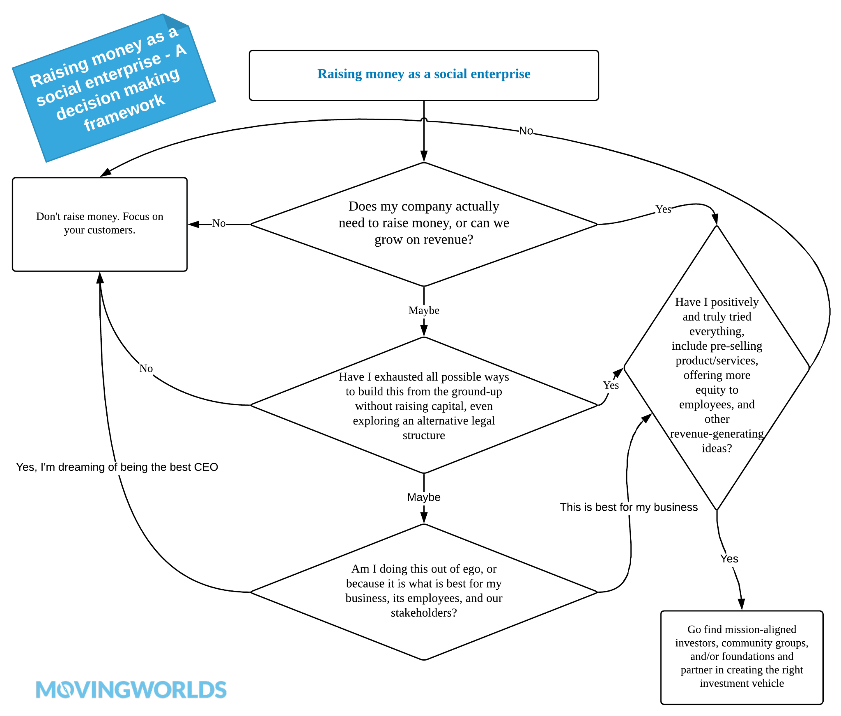
ASK YOURSELF
Notes:
https://movingworlds.org/social-entrepreneurship-guide

Slide 4
Pitch deck general info
Keep your deck short. Your goal is not to provide investors with all necessary information which they need to invest in your business. Your aim is to tell a compelling story, build excitement and cover the crucial areas to spark interest and make sure there will be a follow-up.
Keep your deck up to date. Make sure it includes the most recent information, especially your traction and business metrics.
Don’t share open files like ppt or doc. Use pdf or links to your online fundraising deck.
Containing about 15-25 slides (you can add appendices)
You should practice to pitch a maximum of up to 3 minutes
Your pitch should be an easy-to-read and understand piece
Make sure you practice a lot in order to master your pitch

Slide 5
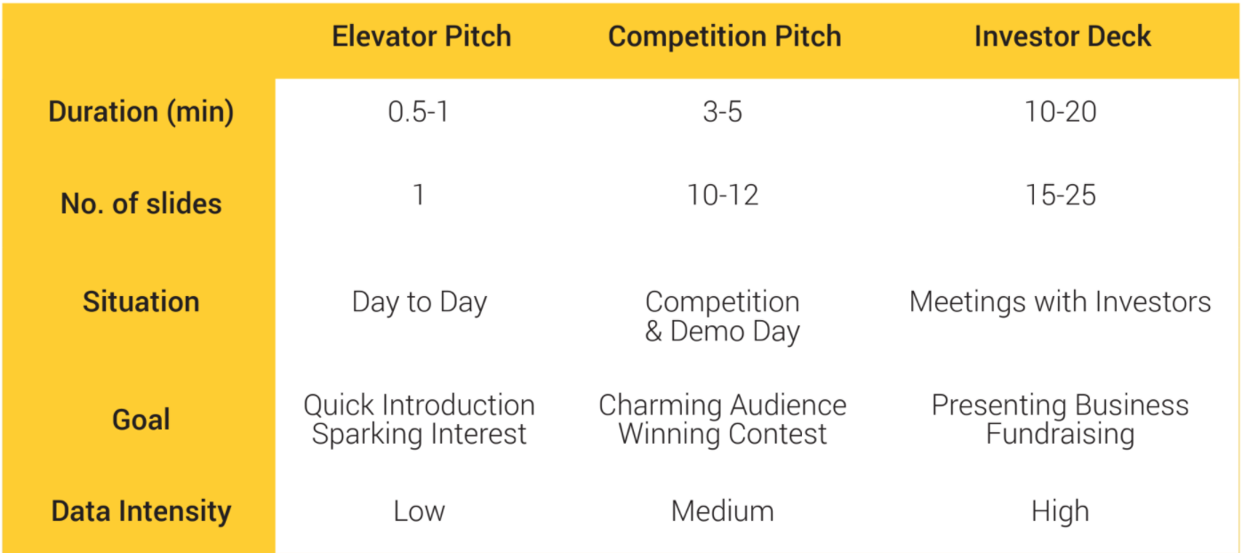
Types of pitches

Slide 6
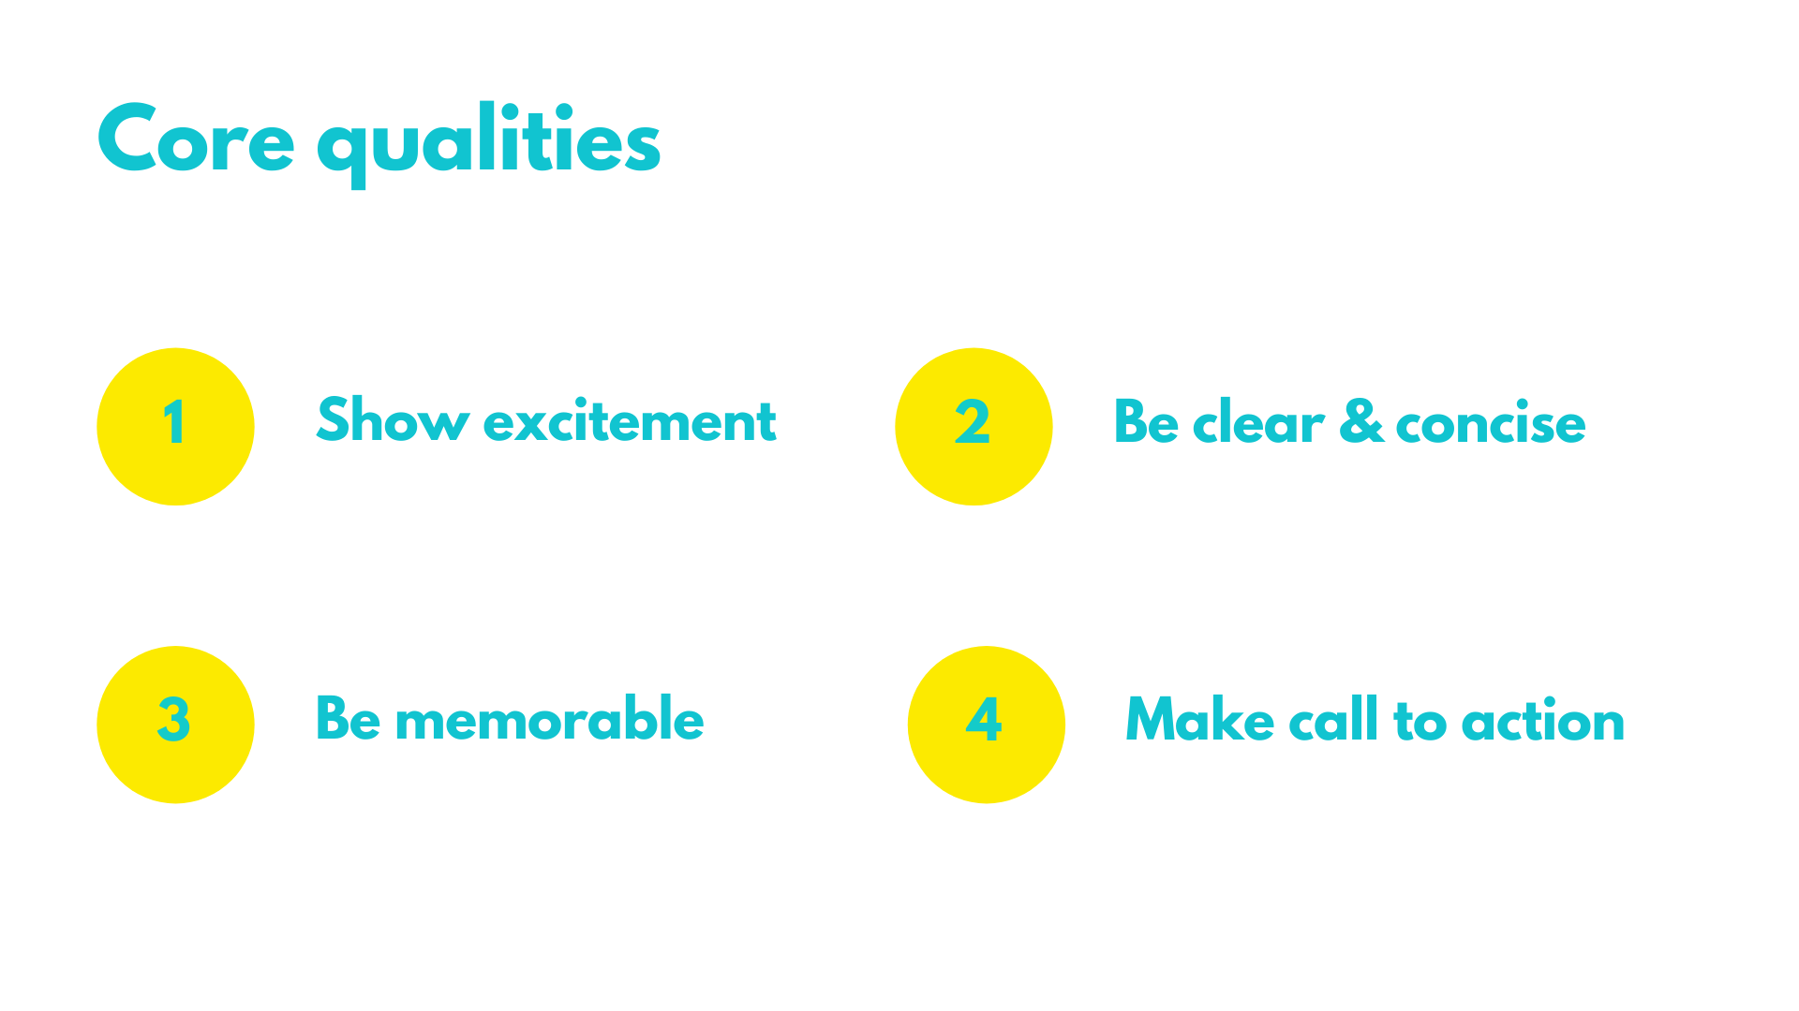

Slide 8
START WITH THE HOOK
Tell your story. Tell something that audience and investors will remember

Slide 9
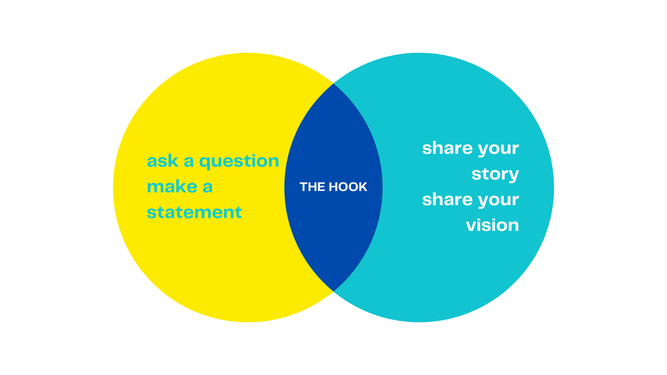

Slide 10
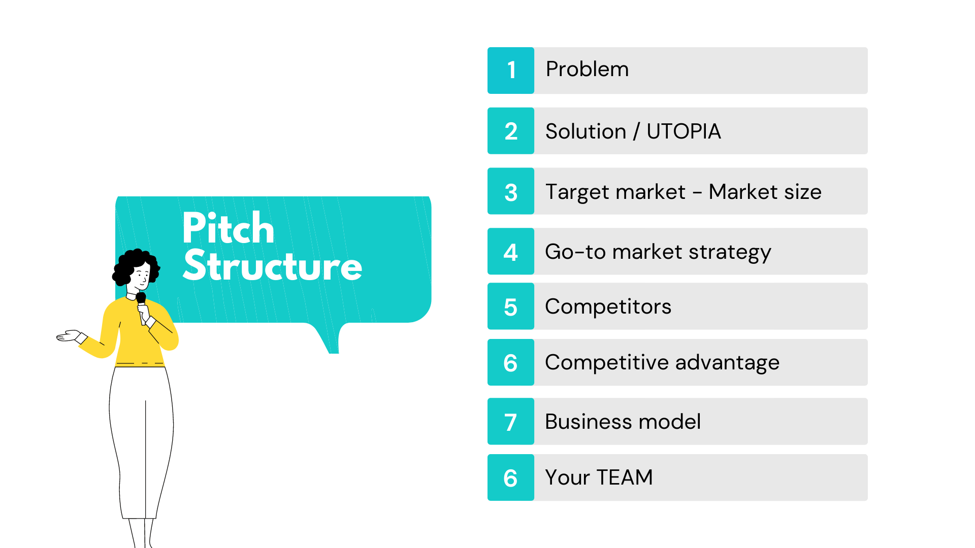

Slide 11
The problem:
List 3-5 problems your company/product observes and wants to solve.
What is the real problem your customer faces? Describe the problem, show how it affects the end user. The more severe and painful the problem of customers is, the higher the demand for your solution and the bigger the interest of the investors for the funding your project.
This part is a deal-breaker for investors so having a clear user case is of key importance here. Use a real customer story or a personal experience to illustrate the problem and let investors feel the ‘difficulty’.

Slide 12
EXAMPLE:

Slide 13
The social problem
List a social/environmental problem your product observes and wants to solve.
This problem will indicate how the consumption or production of the product minimizes, decreases, eliminates some identified social/environmental problem.
Unlike business investors, social investors are moved by stories of change.

Slide 15
The solution:
List 3-5 ways your company proposes to solve them.
It is time to introduce the remedy for existing pain points. Demonstrate your product’s benefits and uniqueness and explain how it solves your customer’s problem.

Slide 16
EXAMPLE:
Notes:
https://www.slideshare.net/PitchDeckCoach/airbnb-first-pitch-deck-editable

Slide 17
Product or Service:
Introduce your company's product or service as the ultimate solution to these problems.
In this section explain how your product or service works. Describe the technology and secret sauce behind it. Remember, don’t focus only on specific features. Show how it can change the customer's life. Use a picture, a demo or show a prototype (at least mock-ups).
If you are working on a game-changing solution in high technology sectors, you might need a separate slide to convince investors that no one else can easily duplicate or surpass your product.

Slide 18
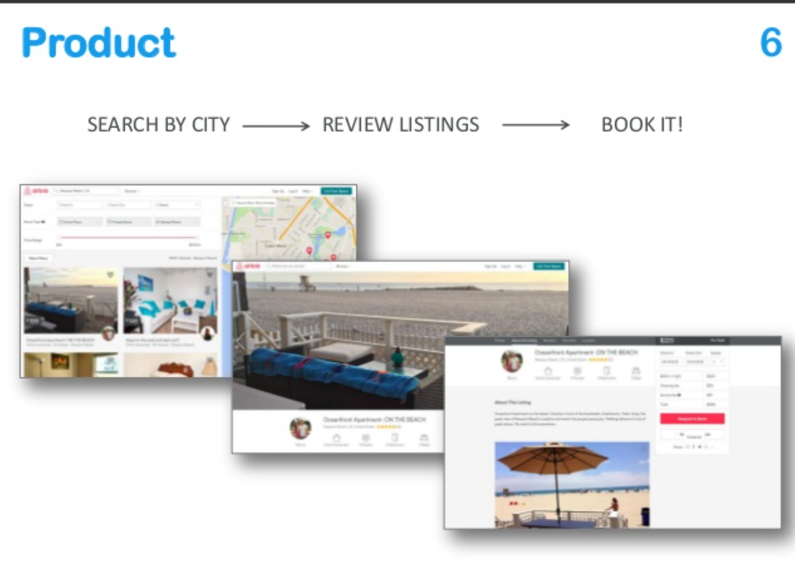
EXAMPLE:
Notes:
https://www.slideshare.net/PitchDeckCoach/airbnb-first-pitch-deck-editable

Slide 19
Target Market:
Focus on determining the following:
🖲 Who is your customer?
🖲 Does your market already exist or do you plan to create a new one?
🖲 Do you go global or focus on some specific region?
🖲 What is the Total Addressable Market? TAM includes everyone you think you can reach with your product.
🖲 Show reliable assumptions by breaking down your market into segments and targeting a very specific and reachable part of the potential customer group.
🖲 Prioritize segments and provide the audience with justification on which segments you are going to reach first.
🖲 Make sure to support your story with relevant data, statistics and reports from trusted sources, since in this way you confirm the deep knowledge of your customers.

Slide 20
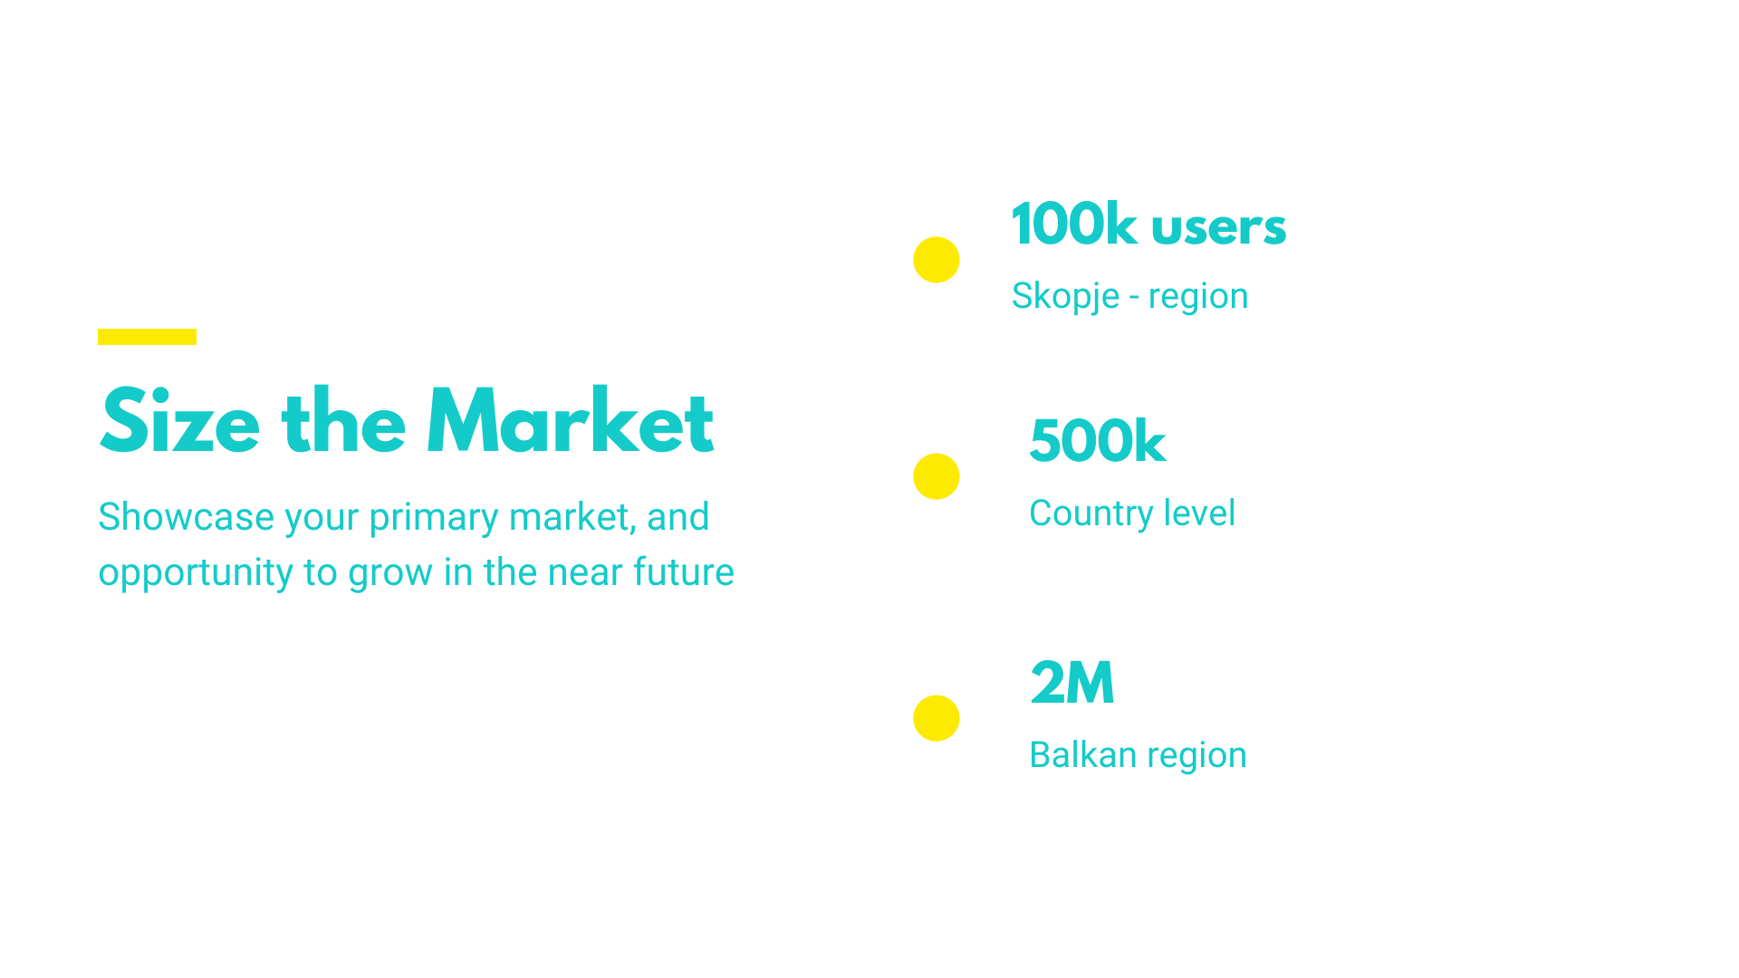

Slide 21
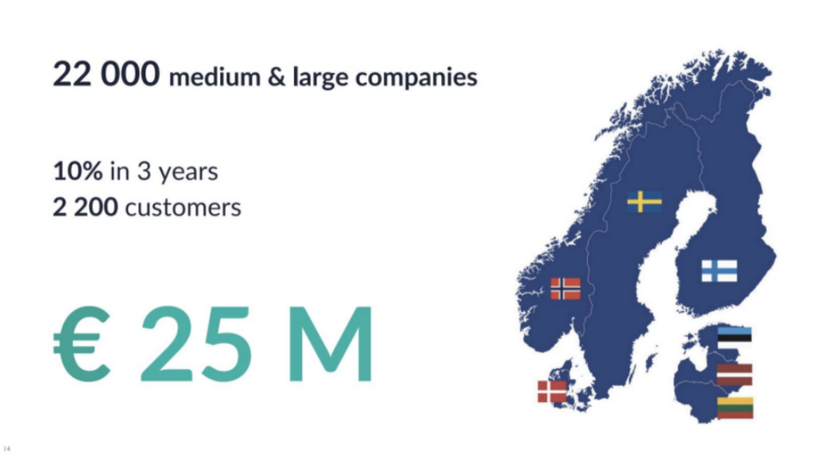
EXAMPLE:

Slide 22
Competition:
There is no business without competitors. If you think so, do your research better (there are for sure some indirect competitors), or think twice whether your idea will really work.
Even if you found a brand new product or service, it is likely that your potential clients had already solved the problem somehow. Their solution might be ineffective and complicated but still the consumers don’t sit and wait until somebody will satisfy all their needs.

Slide 24
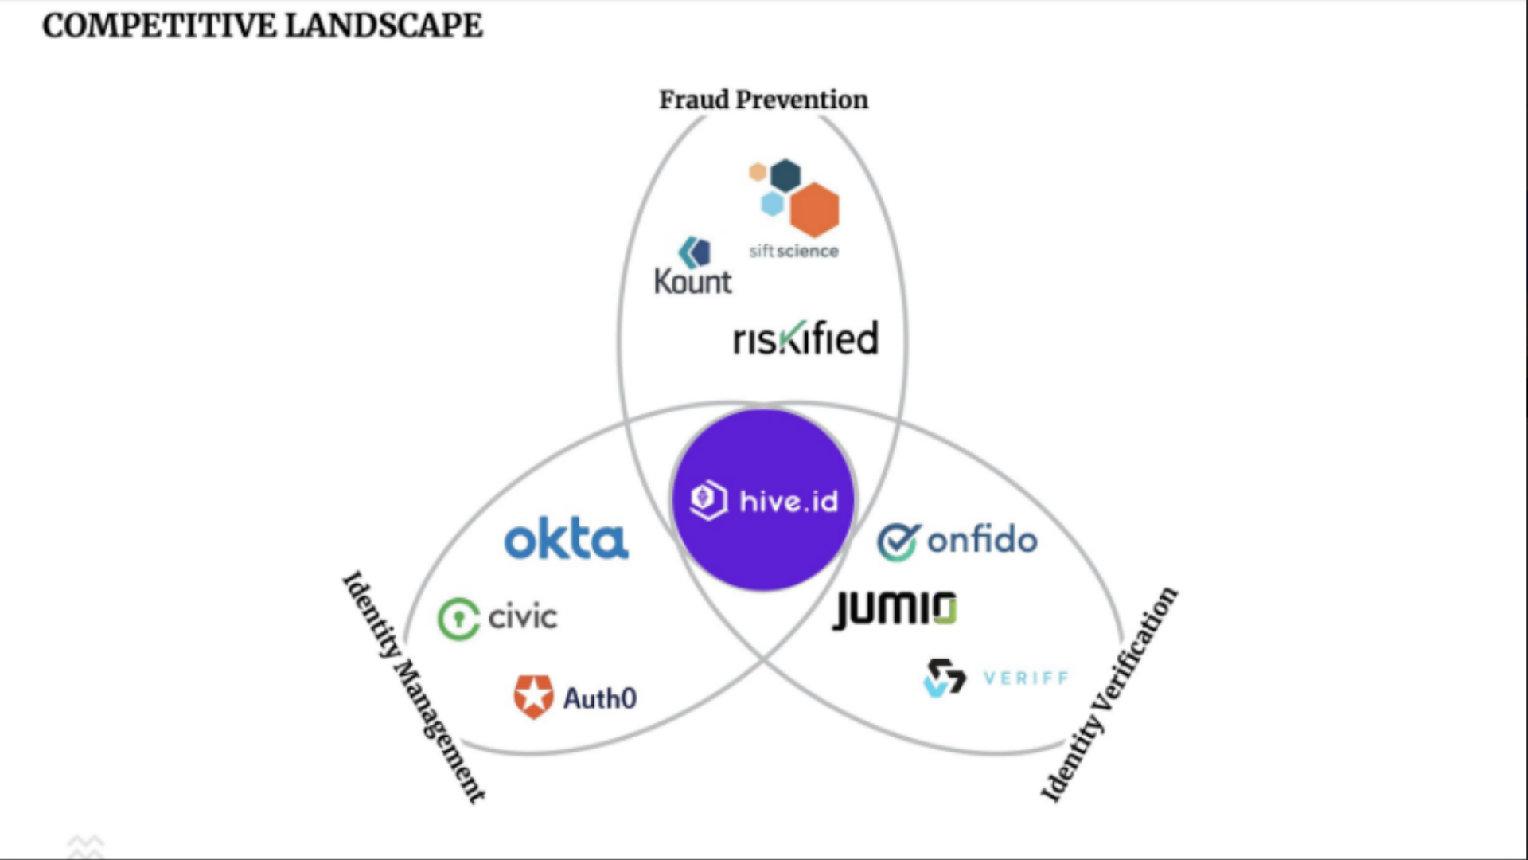
EXAMPLE:

Slide 25
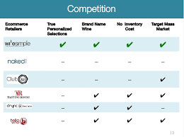
EXAMPLE:

Slide 26
List your impact:
Green and social enterprises always have outstanding competitive advantage, because they are offering more than just a service or a product.
When developing your business plan or strategy, please be aware which SDGs your solution is part of. When a team outlines SDGs and shows this to investors, it means you (and the team) understand the depth of your project/product/service

Slide 27
EXAMPLE:

Slide 28
Go-to-market strategy:
Once you know your market, you have to decide how to attract the customers and promote your solution. Many startups fail at this point, because they forget that having a good idea, product or service is simply not enough. Even if you invented something absolutely fantastic, you still have to reach your target audience.
In addition, you need to take into account the maturity and specifics of your chosen market. You might need a different approach for innovators, early adopters or early majority. So make sure you understand your market specifics before shaping your strategy.
Knowing your customer segment, think about how you can get to your target market, what communication channels you should use, where and how you should sell the solution. This should be aligned with lifestyle, habits and needs of your potential clients.

Slide 29
EXAMPLE:
Notes:
https://lerablog.org/business/marketing-business/create-a-well-developed-go-to-market-strategy-for-optimized-decision-making/

Slide 30
Business model:
Business model is about how you are going to make money. It’s not only about revenue streams and pricing, but your overall business strategy. Here the math you did has to start working.
Good news is that investors understand that it is very hard for a young company to build an accurate model and they expect basic assumptions, to know where you are heading.
The truth is that your revenue and pricing model will be a subject to many changes over time.

Slide 31
EXAMPLE:

Slide 32
TRACTION/FINANCIAL
Show investors what milestones you have accomplished so far. Your aim is to prove that your business is well-balanced, viable and able to monetize acquired customers.
Pick a wide range of metrics suitable for your industry like:
🖲 Average Revenue Per User (ARPU)
🖲 Customer Acquisition Cost (CAC)
🖲 Life-time Value of a customer (LTV)
🖲 Registered users
🖲 Conversion and retention rate
Don’t forget to outline a press coverage, strategic partnerships and customer success stories. If you overcame some challenges and obstacles, this is a good place to mention them and show your capability of handling things. The same is if you already have clients show your sales trajectory.
If your company is at early stage and pre-revenue with product in development, draw at least a timeline with achieved milestones. It can be a product development, interviews with clients, letters of intent, number of beta testers, downloads or newsletter subscription, taking part in acceleration program or even winning a contest - whatever proves there is interest in your company or your product.

Slide 33
EXAMPLE:
Notes:
https://www.basetemplates.com/

Slide 34
THE TEAM
Investors firstly invest in teams, and than in ideas
Show off your team with your roles. Keep in mind to have pre-defined roles.
Every team should be carefully balanced.

Slide 35
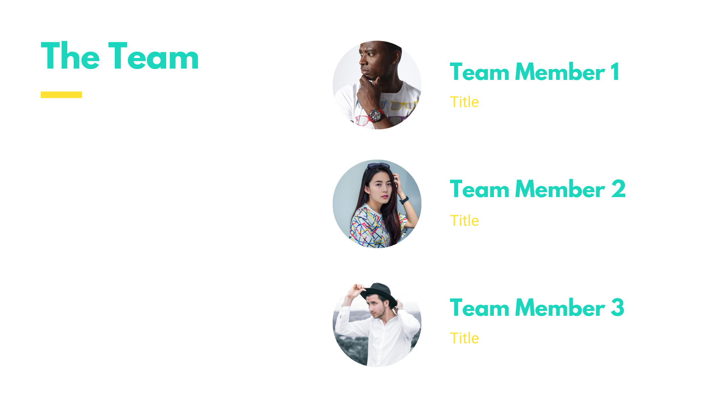

Slide 36
THE BIG ASK
In this section focus on answering the following questions:
🖲 How much money do you need?
🖲 What will you accomplish with that money?
🖲 % of equity you are willing to give up to the investor
🖲 How much have you raised so far and from whom?

Slide 37
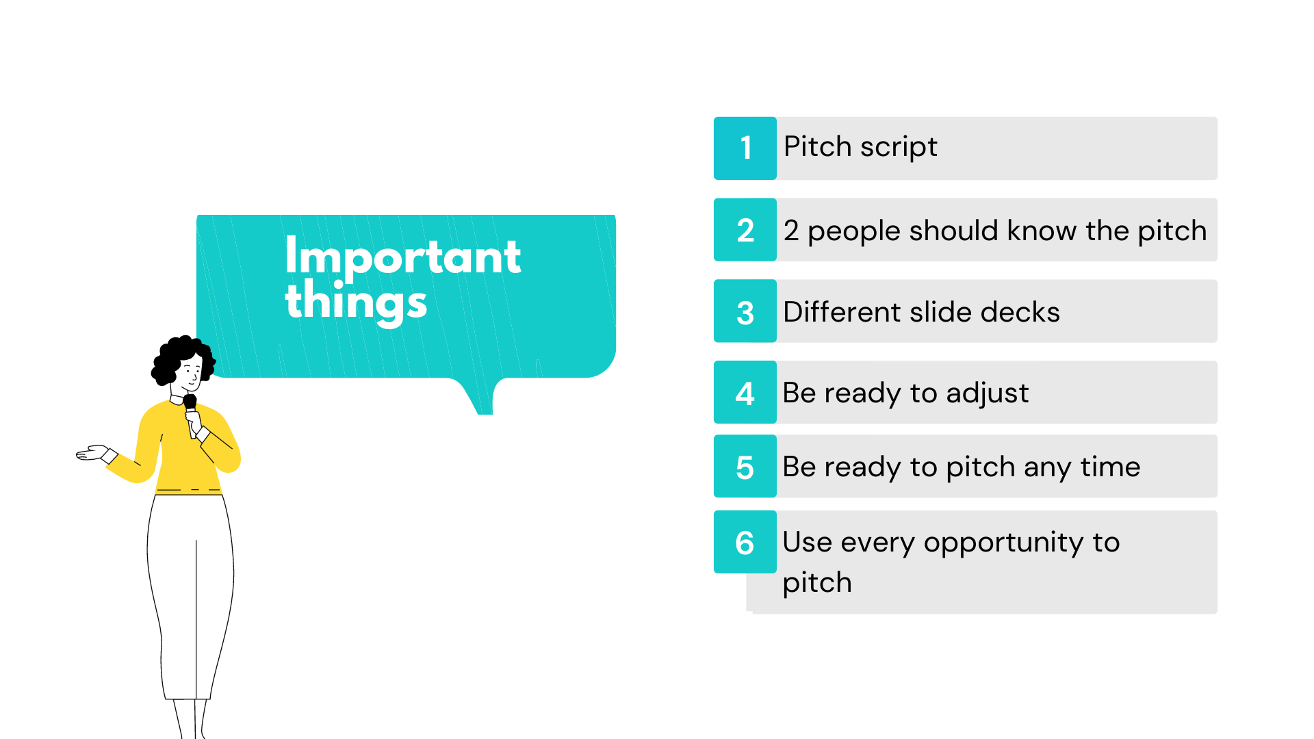

Slide 38
Notes:
https://quotefancy.com/quote/887185/Pel-Everything-is-practice

