Slide 1
Module: Еco Design

Slide 2
MEANING AND NEED OF ECO DESIGN

Slide 3
Eco design represents an integral project activity in which the focus is a designer/engineer that with making decisions is mainly lead by the consequences on the environment, and takes into consideration all the phases of the life cycle: from extraction of raw materials to removal of the product.
Through implementation of an eco-design, it can limit the influence of the product on the environment, for the whole lifespan of the product.
Main criteria taken into consideration:
Consumption of raw materials
Consumption of energy
Releases in the environment and other pollution types
Climate influence
Influences on biodiversity

Slide 4
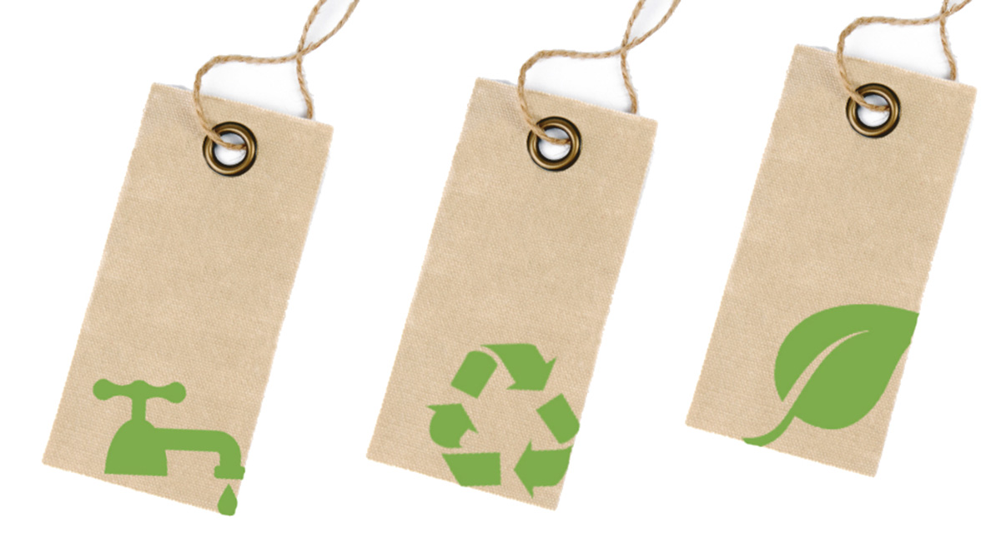
Practical eco-design has the goal of improving the product in order to determine the lifecycle for saving on energy, waste, radiation and toxins.
Still, sustainable design of products has to include concepts of ecological services, such as using connected products, lease of ambience and sharing, and the ethical and special questions appearing in the process of sustainable design must not be neglected.

Slide 5
MAIN PRINCIPLES AND PHASES OF ECO DESIGN
Eco-design is based on defined component in which certain innovations are overlapped, products and services that include improvement (mainly) on ecological level for the product and services.
In the process of designing, also significant importance is given to social and ethical aspects, and this concept is then considered as sustainable design or design for sustainability (D4S – Design for Sustainability).
With that goal, manufacturing, as well as the consumer can be analyzed. For example, what can be improved in manufacturing in terms of energy consumption?
When it comes to consumers, there could be exploring of ways to encourage the consumer to engage in more sustainable purchases or manifesting more sustainable behavior.

Slide 6
When it is time to plan and combine a long term sustainable development, then it has to be in accordance with the needs of manufacturing and consumption on one hand, and suitable environment for life preservation on the other.
The whole economic activity of one organization is reflecting on the environment, but through eco-aware managing it can be lead with activities that have or might have influence on the environment.
Its goal is to protect the natural resources, decrease the pollution and risks on the environment, and preserve the health of the employees and surrounding population.
Manifestations on sustainable eco-design require renewable resources, minimal influence on the environment and linking people with the nature.

Slide 7
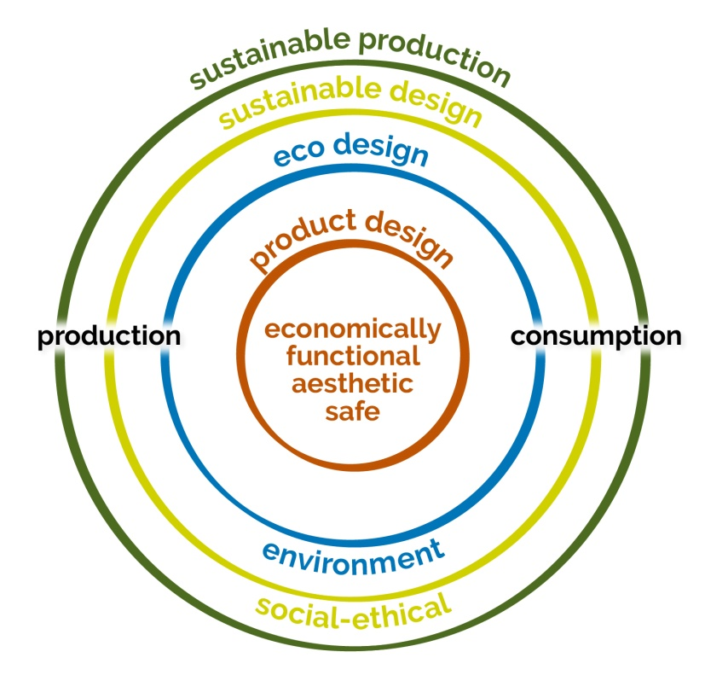
D4S is a concept for eco-design that evolved to include the special and economy elements of manufacturing
It integrates the three pillars of sustainability – people, profit, and the Planet, but it also goes a step further with “making green” products in order to see how to satisfy the needs of consumers in a more holistic, sustainable way.
The companies that incorporated DS4 in their long term strategies for innovations, are also focused on mitigating the negative influences on the environment, special and economy influences over the product supply chain and through the lifecycle of manufacturing.

Slide 8
The research program of D4S includes:
Systematic development,
Testing and international diffusion of methods and tools for design of products with superior lifecycle,
Improved eco-efficiency and effectiveness (through intelligent materials and energy applications, integration of new manufacturing technologies and economical optimization).

Slide 9
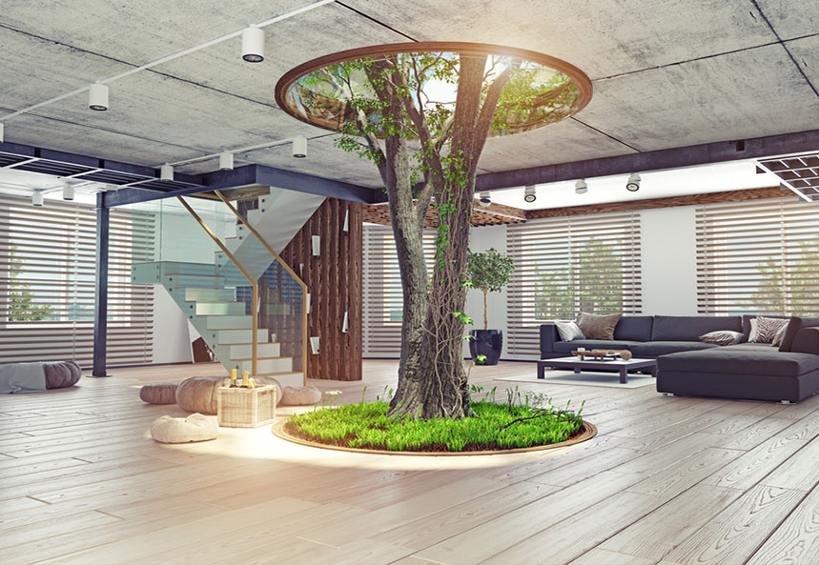
The challenges of D4S are to generate knowledge for support of innovation and designer engineering of products and service systems with superior sustainability and optimal usage of network linking and entrepreneurship as factors for implementation success
2
+
https://www.youtube.com/watch?time_continue=23&v=_Zt9UxsEnPc&feature=emb_logo

Slide 10
Used Resources:
D. S. Anita Grozdanov, regular professor оф Polymer Processing, Faculty of Technology and Metallurgy, University Ss Cyril and Methodius in Skopje.
https://www.youtube.com/watch?time_continue=23&v=_Zt9UxsEnPc&feature=emb_logo

